Slide 1
#BeReady16:
working together for our
military and overseas voters Federal Voting Assistance Program
Election Assistance Commission Standards Board
15 April 2016

Slide 2
UPDATE ME Federal Voting Assistance Program
Update Me
8 February 2016

Slide 3
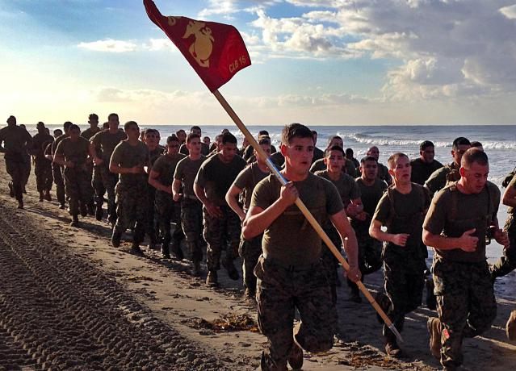
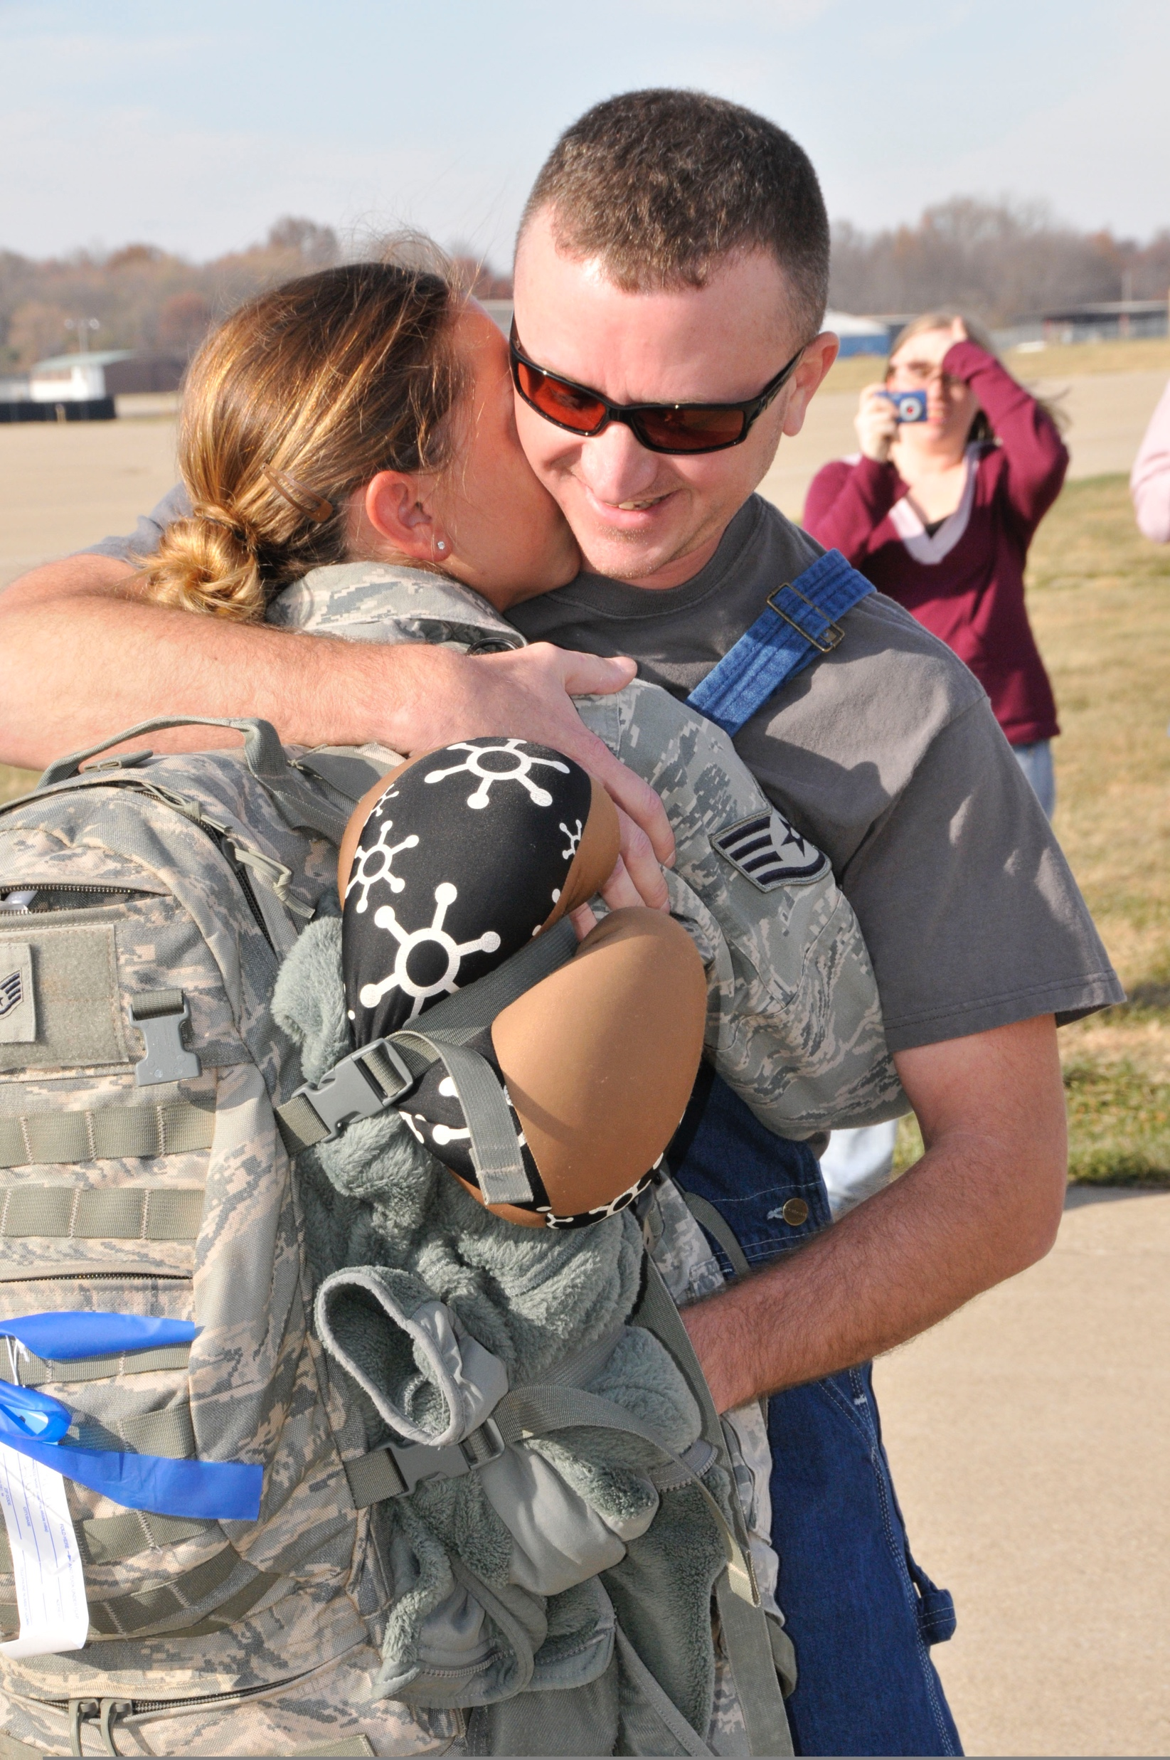
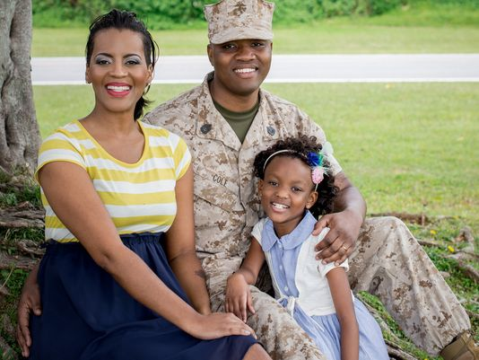
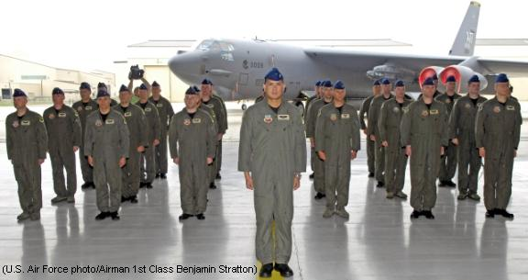
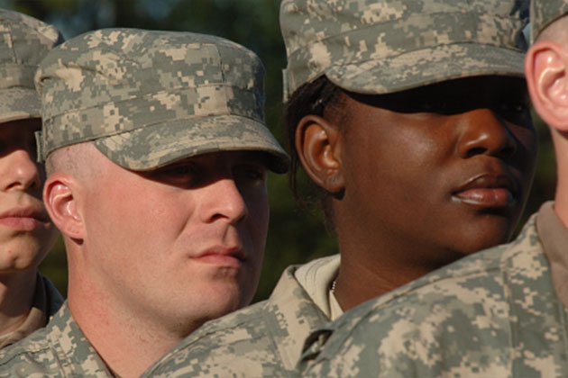
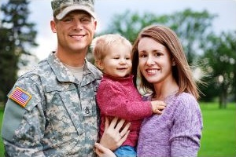
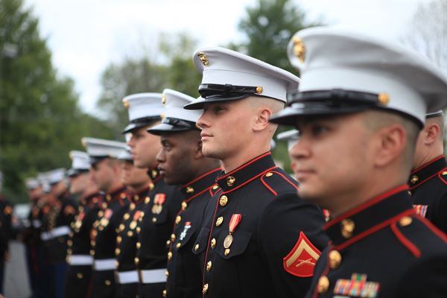
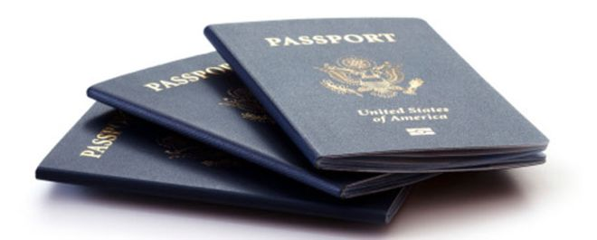

Slide 4
FVAP’s renewed focus
The electronic voting demonstration project was repealed.
FVAP returned to its focused on providing customer service for UOCAVA voters, Voting Assistance Officers and Elections Officials.
Shift from presenting data to analyzing data
tell a story with data
While we see progress, we see challenges as well in serving the unique characteristics of the UOCAVA population.

Slide 5
Challenges
Mobility
Complexity
Disconnected from Voting Community
Communication
Notes:
Storytelling, in the form of personas, is one of the most effective ways to translate research data
into information that resonates with decision makers and priority audiences.
The personas presented here are based on data analyses using the Federal Voting Assistance
Program’s (FVAP) 2012 Post-Election Survey of Active Duty Military, the 2012 Post-Election Survey
of Spouses of Active Duty Military, and the survey of overseas citizens.
We have analyzed the Active Duty Military (ADM), spouse, and overseas
citizen populations in several ways, including an analysis of their propensity to vote and exploratory
cluster analysis. After thoroughly examining data across available sources to identify patterns and
trends, we employed reasoned segmentation to make sure that personas were representative of
potential Uniformed and Overseas Citizens Absentee Voting Act (UOCAVA) voters. To assess media
usage by various segments, we analyzed Google Analytics data for the FVAP.gov website and used
results from the 2013 Status of Forces Survey of Active Duty Members (SOFS-A).

Slide 6
FVAP facing challenges in a new way
Look to the Data
Cooperative Solutions:
Council of State Governments
EAC/FVAP/MPSA/USPS Mail Emphasis
New Outreach Efforts
Notes:
Storytelling, in the form of personas, is one of the most effective ways to translate research data
into information that resonates with decision makers and priority audiences.
The personas presented here are based on data analyses using the Federal Voting Assistance
Program’s (FVAP) 2012 Post-Election Survey of Active Duty Military, the 2012 Post-Election Survey
of Spouses of Active Duty Military, and the survey of overseas citizens.
We have analyzed the Active Duty Military (ADM), spouse, and overseas
citizen populations in several ways, including an analysis of their propensity to vote and exploratory
cluster analysis. After thoroughly examining data across available sources to identify patterns and
trends, we employed reasoned segmentation to make sure that personas were representative of
potential Uniformed and Overseas Citizens Absentee Voting Act (UOCAVA) voters. To assess media
usage by various segments, we analyzed Google Analytics data for the FVAP.gov website and used
results from the 2013 Status of Forces Survey of Active Duty Members (SOFS-A).

Slide 7
Look to Data - Personas (Use Cases)
Effective way to translate research data
Based on data analyses using:
2012 Post-Election Survey of Active Duty Military (ADM)
2012 Post-Election Survey of Spouses of ADM
Survey of Overseas Citizens
Google Analytics for FVAP.gov
2014 Status of Forces Survey of ADM (SOFS-A)
Notes:
Storytelling, in the form of personas, is one of the most effective ways to translate research data
into information that resonates with decision makers and priority audiences.
The personas presented here are based on data analyses using the Federal Voting Assistance
Program’s (FVAP) 2012 Post-Election Survey of Active Duty Military, the 2012 Post-Election Survey
of Spouses of Active Duty Military, and the survey of overseas citizens.
We have analyzed the Active Duty Military (ADM), spouse, and overseas
citizen populations in several ways, including an analysis of their propensity to vote and exploratory
cluster analysis. After thoroughly examining data across available sources to identify patterns and
trends, we employed reasoned segmentation to make sure that personas were representative of
potential Uniformed and Overseas Citizens Absentee Voting Act (UOCAVA) voters. To assess media
usage by various segments, we analyzed Google Analytics data for the FVAP.gov website and used
results from the 2013 Status of Forces Survey of Active Duty Members (SOFS-A).

Slide 8
Persona 1: George, Older Overseas Citizen Voter
Media Use and Behavior:
Uses email, does some online shopping, not generally tech-savvy, uses personal computer
FVAP User Behavior:
Likely to visit website directly based on voting experience
Voting Experience:
Registration Likelihood: HIGH
Ballot Return Likelihood: HIGH
Feels voting is an opportunity to express American pride and maintain connection to U.S.
Main sources of voting info: State and LEOs, other ex-pats
Challenges:
Assumes FVAP is for military voters and is unaware of services available for overseas civilians
Sends and receives voting materials in paper form and is not aware of online registration and ballot delivery options
Needs:
A convenient, centralized one-stop shop for current voting information, deadlines, forms
Timely reminders of registration, ballot request and ballot return deadlines
Feedback from LEO about the status of his registration, ballot request and returned ballot

Slide 9
Persona 2: Andrea, Unaware Overseas Citizen Voter
Media Use and Behavior:
Tech-savvy and heavy social media user; accesses Internet on her cell phone and personal laptop
FVAP User Behavior:
Likely to be referred from another source (Dept of State); likely to use online assistant to complete FPCA
Voting Experience:
Registration Likelihood: LOW
Ballot Return Likelihood: LOW
Voted in U.S. no experience with absentee; perceives voting as a way to stay connected
Main sources of voting info: family and friends, other ex-pats
Challenges:
Unaware of right to vote from overseas; unfamiliar with process; unlikely to seek out information independently
Confusion about what State she should vote in; might decide not to participate if she feels process is hard or overwhelming
Needs:
Detailed info about right to vote and process
Information about voting assistance resources
Help identifying her State and its requirements
Timely reminders of registration, ballot request and ballot return deadlines

Slide 10
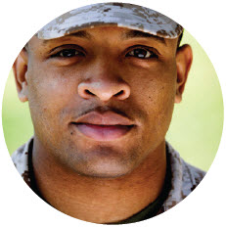
Persona 3: Johnny, Young ADM Voter
Media Use and Behavior:
Tech-savvy and heavy social media user; accesses Internet on his cell phone
FVAP User Behavior:
Likely to directly visit FVAP.gov based on word of mouth and VAO outreach
Voting Experience:
Registration Likelihood: MODERATE
Ballot Return Likelihood: LOW
First-time voter with no experience or knowledge of absentee process; views voting as important right but ambivalent about participating
Main sources of voting info: DoD resources, family and friends, VAO
Challenges:
Voting is not a priority, has little motivation to seek out info independently; might decide not to participate if she feels process is hard or overwhelming
Likely to register but might fail to return ballot without follow-up prompting
Unstable mailing address due to frequent moves
Needs:
Step-by-step info of the process; assistance filling out FPCA
Proactive engagement by VAO; support from Commander
Electronic registration options

Slide 11
Persona 4: Davis, Senior Enlisted ADM
Media Use and Behavior:
Internet access mostly limited to time in ship/computer lab; uses Internet and social media regularly to communicate with family while deployed
FVAP User Behavior:
Likely to directly visit FVAP.gov, though referrals are helpful; likely to use paper forms
Voting Experience:
Registration Likelihood: HIGH
Ballot Return Likelihood: MODERATE
Has voted in the past and generally understands absentee process; believes if he doesn’t vote, can’t complain
Main sources of voting info: DoD resources, spouse, VAO
Challenges:
Has experienced difficulties voting in the past, skeptical his vote will count
Likely to register but may fail to return ballot without reminders/encouragement
Speed and quality of mail system, limited time and Internet access; unfamiliar with FWAB
Needs:
Accurate info about voting rights and reassurance vote will be counted; support from Commander
Timely reminders of registration, ballot request and ballot return deadlines
Feedback from LEO about the status of his registration, ballot request and returned ballot

Slide 12
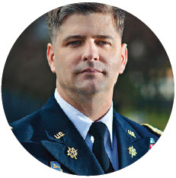
Persona 5: Arlo, Military Officer
Media Use and Behavior:
Internet access primarily through personal computer; uses email and Facebook to communicate with family/friends
FVAP User Behavior:
Likely to directly visit FVAP.gov without referrals
Voting Experience:
Registration Likelihood: HIGH
Ballot Return Likelihood: HIGH
Extensive experience voting absentee; views voting as civic duty and takes it very seriously
Main sources of voting info: DoD resources, spouse, VAO
Challenges:
Has experienced difficulties voting in the past, including not getting ballot on time; sometimes unsure whether ballot was counted
Feels unprepared to assist Service members who look to him for guidance about voting; struggles to discuss voting without discussing politics
Needs:
Reliable, up-to-date information about the voting assistance resources available that he can share with subordinates
Timely reminders of registration, ballot request and ballot return deadlines
Feedback from LEO about the status of his registration, ballot request and returned ballot

Slide 13
Persona 6: Hanna, Military Spouse
Media Use and Behavior:
Uses Internet and social media to communicate with family/friends; use cell phone and personal computer
FVAP User Behavior:
Likely to be referred to FVAP.gov by online sources or through independent search
Voting Experience:
Registration Likelihood: MODERATE
Ballot Return Likelihood: MODERATE
Sometimes voted in home jurisdiction but unfamiliar with absentee process; recognizes voting as an important right
Main sources of voting info: DoD voting assistance resources, spouse and other military families, VAO
Challenges:
Would like to vote but has little knowledge of process; limited time/energy to figure out process
Often receives inaccurate information through social network of military families and is unsure who can be trusted as a source of reliable information
Needs:
Step-by-step info of the process and available resources
Timely reminders of registration, ballot request and ballot return deadlines
Assistance communicating important info to spouse

Slide 14
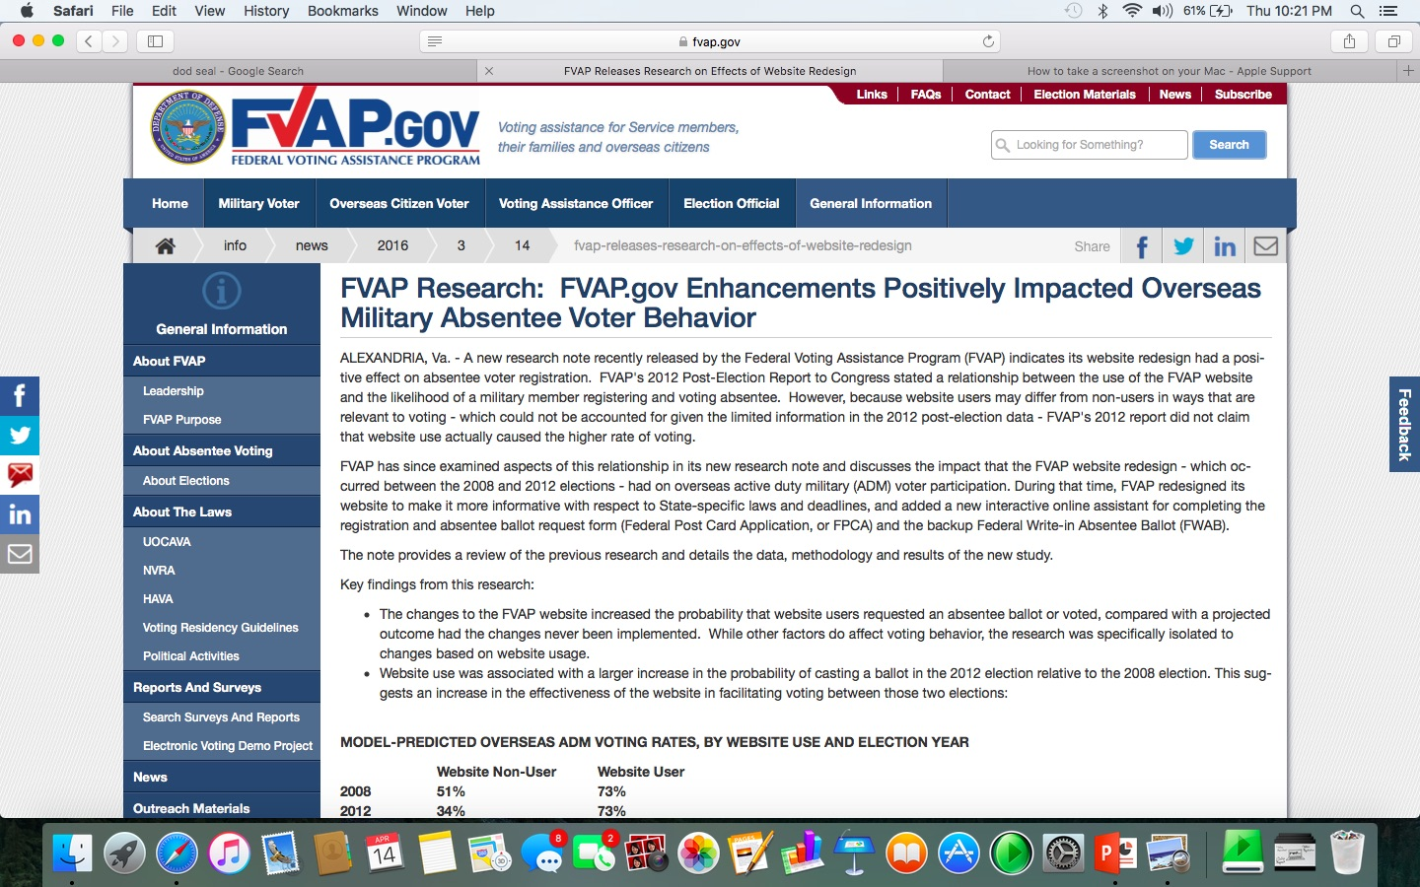
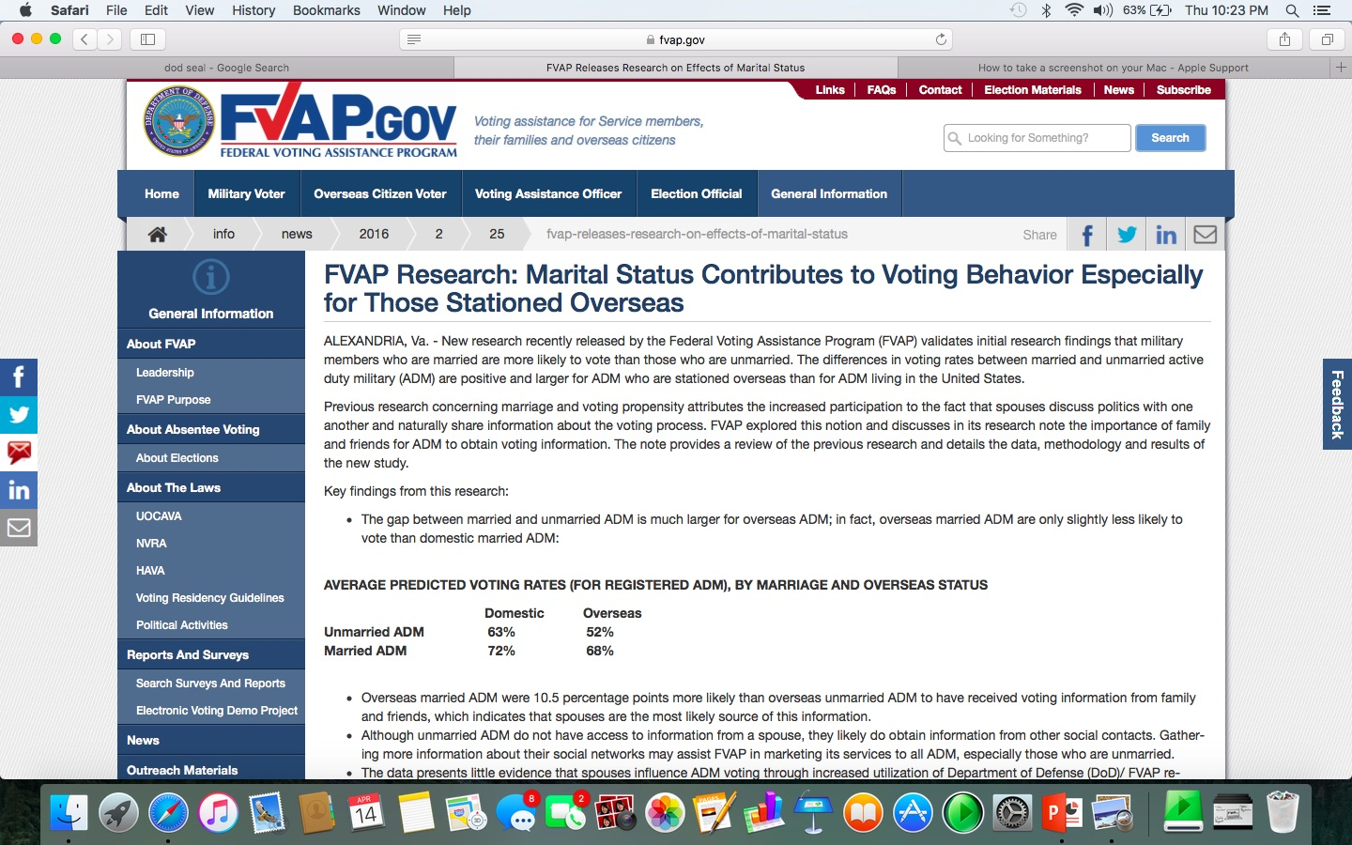
Look to Data - FVAP Analysis

Slide 16
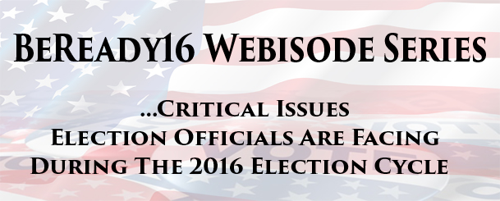
Working Together for You and Your Voters….

Slide 17
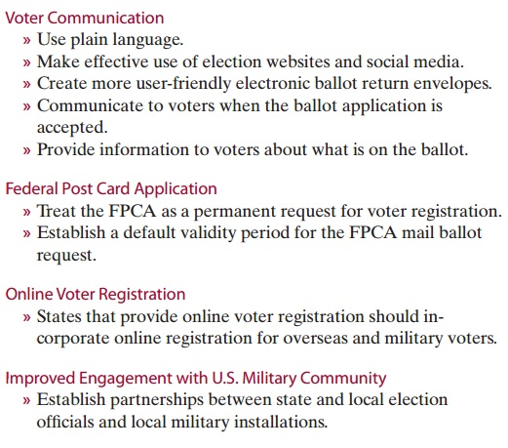
Working Together – Policy Working Group

Slide 18
Working Together – Technology Working Group
Ballot Duplication
Data Standardization
Use of the DoD Common Access Card
Ballot Tracking Pilot Project

Slide 19
Working Together – EAVS Section B Working Group
Clarify Language and Instructions for 2016
Develop Roadmap for the future
Understand the role of Data Standardization
Look to transactional election data for voter success metrics

Slide 20
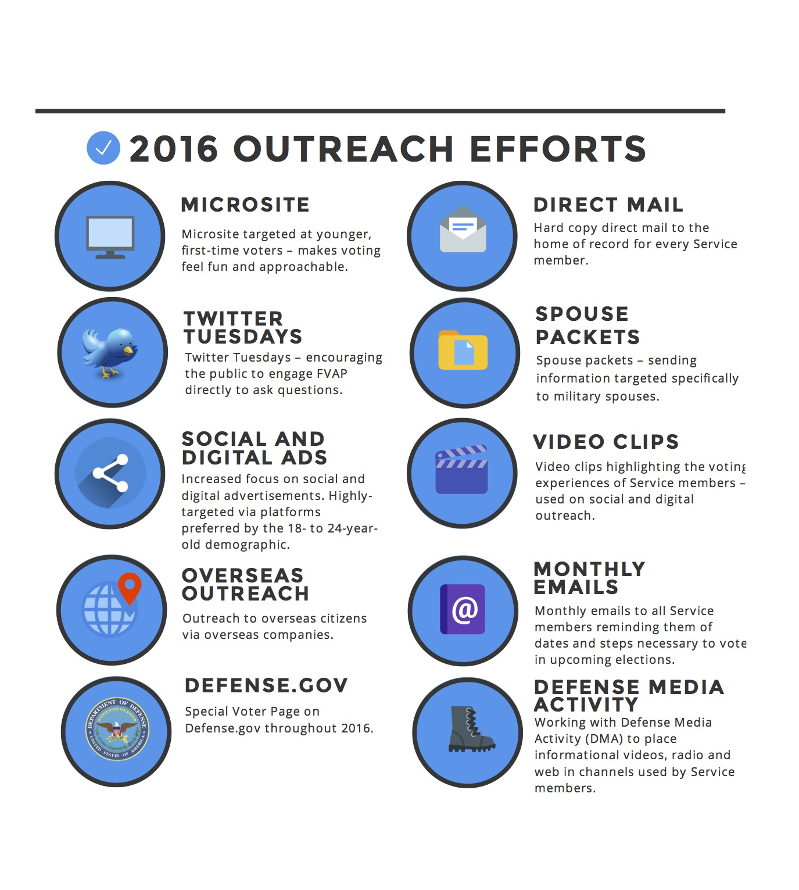
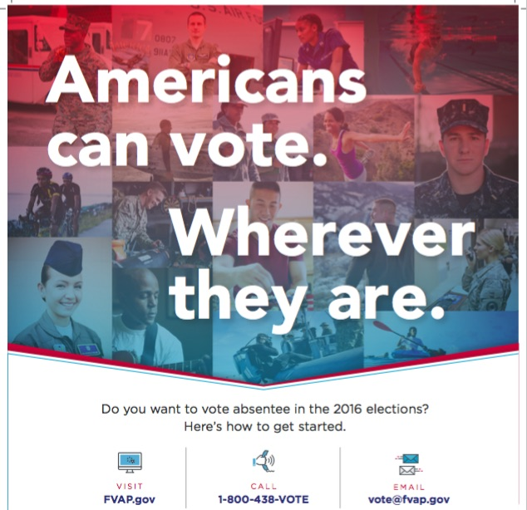
FVAP #BeReady16

Slide 21
What can the Standards Board do?
Continue to set the bar high for the work of the EAC
Challenge the Status Quo and embrace change
Continue to push the EAC and FVAP to develop technologies and programs/services for our UOCAVA voters
SERVICE ALL VOTERS
VOTER EXPERIENCE & SUCCESS BECOMES PRIORITY
DELIVER ”THE WOW” PHILOSOPHY

Slide 22
What Can We All Do?

Slide 23
UPDATE ME Federal Voting Assistance Program
Update Me
8 February 2016

Slide 24
Let’s all do this together
Our military and overseas voters need our very best

