Slide 1
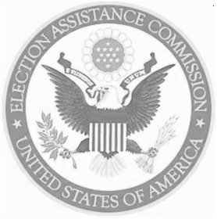
State Testing and Certification Conference Update
Merle S. King, KSU Center for Election Systems - Brian Hancock, Election Assistance Commission
EAC Standards Board 2016 – Carlsbad, CA

Slide 2
The Issue:
Federal testing of voting systems provides a detailed, but intentionally narrow scope
States recognize the need to provide infrastructure to support state-centric testing
There is no formal training and/or certification for the knowledge and skills required to test voting and election systems
The terrain is constantly changing

Slide 3
Interaction of Voting and Election Systems
DMV
Online VR System
(re)Districting
Systems
GIS
Candidate Qualifying System
VR System
Auto VR System
Auditing
Systems
Voter Information
System
E-pollbooks
Pollworker/
Staff
Training Sys.
Voting System
Define Bal. | Cap & Tab
Reports | Audits
Ballot Tracking System
Barcode
Scanner
Statewide
Election Night Reporting
UOCAVA /
Ballot Delivery/Return
Ballot Marking System
Ballot on Demand
Administrative Reports
+-
Voter Authentication System
Ballot Printing
Precinct Mgt Systems
Absentee Application
© 2016

Slide 4
Purpose:
Share best practices for state-level testing of voting and election systems
Create a network of testing professionals
Create a venue for publishing research on testing issues, methods and strategies
Mentor newcomers
Create a repository of papers and presentations for future practitioners
Integrate and leverage state and federal testing

Slide 5
State Certification Conference Origins:
Ideas for the conference originated from a series of discussions and reflections on how the EAC could be more responsive to assist the States in their certification efforts and how States themselves could become more responsive to their own shared needs related to system certification.

Slide 6
Conference History at a Glance:
2011: Initial State Certification Conference held at Kennesaw State University Center for Election Systems, Kennesaw, GA, 27 attendees.
2012: Conference held at the Ball State University Bowen Center for Public Affairs office in Indianapolis, IN. Hosted by the Indiana Secretary of State,36 attendees.
2013: Conference held in Harrisburg, PA. Hosted by the Pennsylvania Secretary of the Commonwealth, 42 attendees.
2014: Conference held in Denver, CO. Hosted by the Colorado Secretary of States Office, 55 attendees.
2015: Conference held in Seattle, WA. Hosted by the Washington Secretary of State, 84 attendees. 32 presentations/papers accepted.
2016: Conference to be held at Massachusetts Institute of Technology (MIT) in Cambridge, MA. June 20-21, 2016. Co-Hosted by MA, CT, and N.H. Anticipated attendance of 40-50.
2017: Austin, TX. - 2018: Stay tuned.

Slide 7
2016 Conference Agenda items:
Considerations for Implementing Voting Systems with COTS Products
Colorado Uniform Voting System Project: Lessons Learned
State Priorities for Common Data Format Specifications
Aging Voting System Laws in Texas
Social Media & Certification
EAC and State of California voting system standards mapping project
Noise in the System: Fervent Advocacy, Forests and Tree

Slide 8
Mini Case Studies:
“California Ballot Printing Certification” – Ryan Macias, California 2015
Described best practice for testing and certifying BOD devices in California. Important information for other states considering adopting BOD technologies and BOD standards for state certification.

Slide 9
Mini Case Studies:
Description of new process for voter registration.
Information received electronically from DMV database into an SOS database.
• No paper exchange from the DMV to elections officials for address updates or new registration forms
•Notification mailed that details the new registration status unless voters return the card declaring they wish to opt-out within 21 days.
Communications, technological and legal issues noted. Update at 2016 Conference.
“Oregon’s New Motor Voter Law: How it Will Work and the Implementation Phase” - Codi Trudell , Oregon -2015

Slide 10
Mini Case Studies:
“Designing and Conducting an Audit of an Election Anomaly”
Dr. Jay Bagga, Dr. Joe Losco Dr. Ray Scheele, Sujan Pradhan, MS, Indiana
2014
Described an issue during the 2012 General Election in Indiana county using a DRE voting system.
Anomaly manifested in under-reporting of 3,791 walk-in absentee votes.
Investigation, information gathering and reporting process.

Slide 11
Mini Case Studies:
Wisconsin Government Accountability Board project to evaluate whether certain modem technology can be approved for use with voting equipment in Wisconsin. Staff developed “Voting System Standards, Testing Protocols and Procedures Pertaining to the Use of Communication Devices in Wisconsin.”
Issues noted included analog vs. VOIP technology.
Election Day security protocols clarified that modeming shall only be used for the transmission of unofficial results. Staff also recommended Board adopt post-election equipment audits during the initial period of use.
“Developing Test protocols and Procedures for Testing Modeming Technology” – Sherri Ann Charleston, Wisconsin - 2013

Slide 12
Mini Case Studies:
“Challenges in Implementing Vote Centers with Current Voting Equipment”
- Erik Reichstein , Arizona 2012
Described the need to add supporting technology such as epollbooks and BOD printers as well as finding equipment that is certified, cost effective, adaptable and easy to use. Challenges noted were dramatic start-up costs and logistics in large counties (6,600 ballot styles)

Slide 13
Why is the Conference Important?
Testing and certification is no longer a periodic and episodic function related to the purchase of an vote tabulation system.
Effective programs must be persistent and consistent, spanning administrations and developing effective internal process and institutional memory.
Proliferation and expansion of your election systems require dedicated and qualified teams.

Slide 14
Why is the Conference Important?
Everyone is involved. Only 1st time attendees exempt from making presentations.
State certification staff see that their work product informs work in other jurisdictions and may have a nationwide impact.
Allows local jurisdictions to leverage State certification representatives as additional resources on an ongoing basis.
Allows EAC to assess the needs of State certification efforts and how we can better serve jurisdictions around the country.

Slide 15
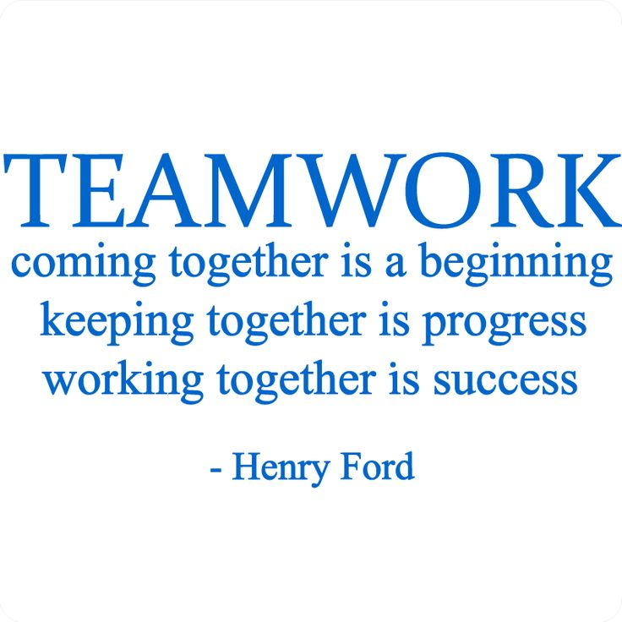
This Conference represents real Federal and State cooperation since 2011…..
mking@kennesaw.edu / bhancock@eac.gov

