Slide 1
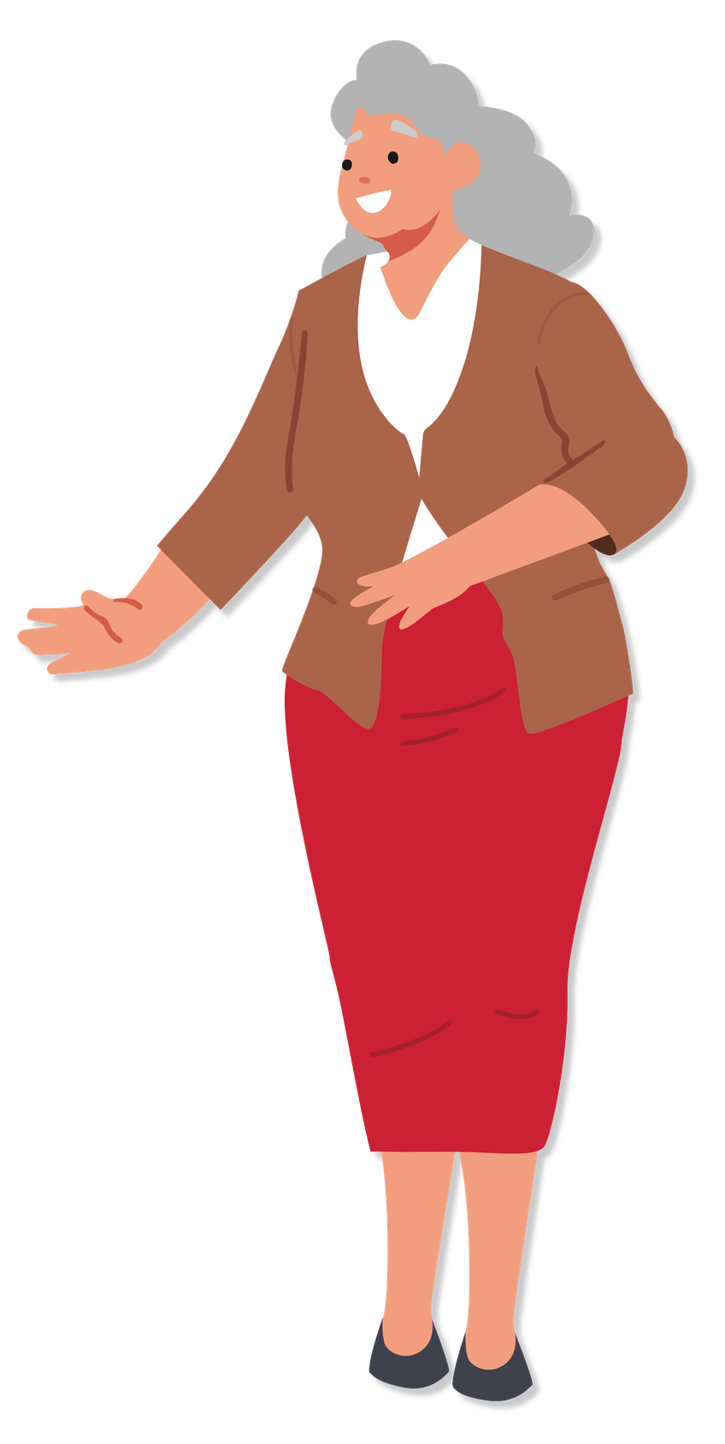
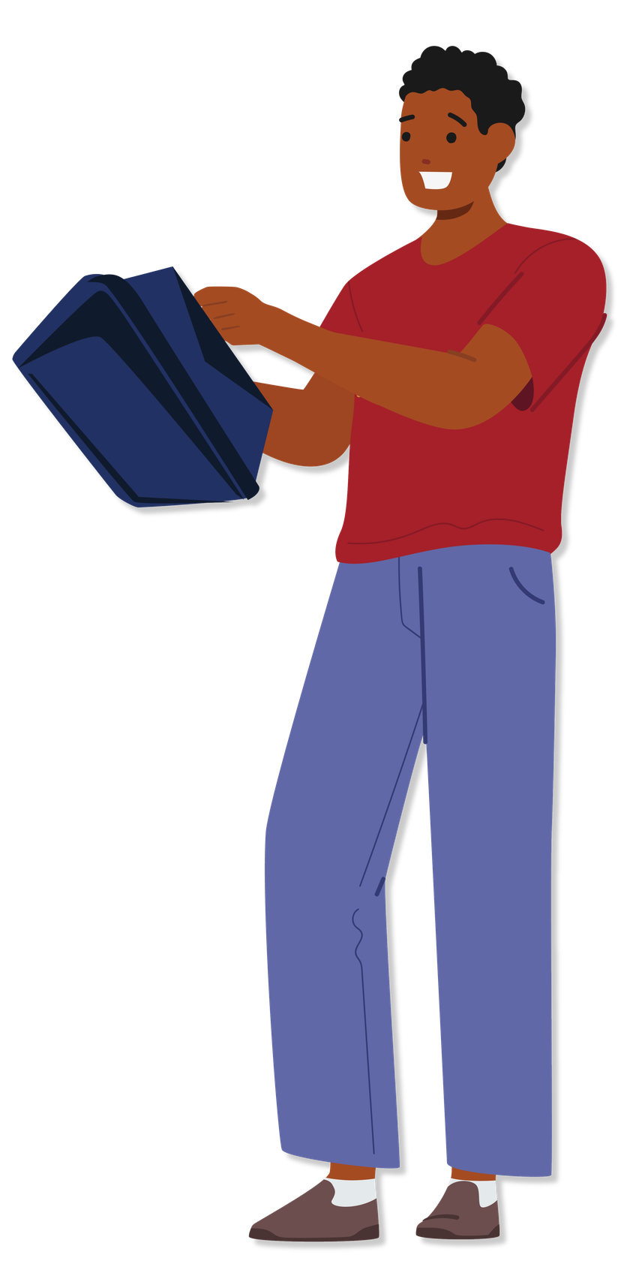

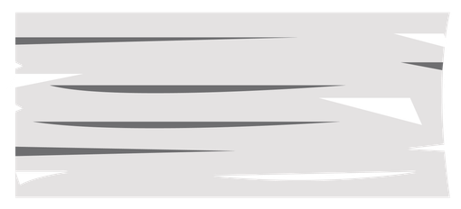
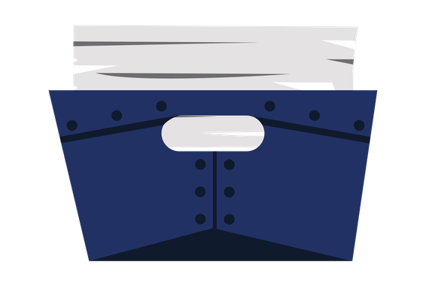

Meet the Audit Team
Notes:
SOCIAL COPY
The work doesn't end on Election Day. Officials take a close look at election processes before, during, and after each election.
For more information, check: [Insert link]
ALT TEXT
A light blue background with an illustration of a woman using red binoculars,
dressed in a blue dress. To the left of the illustration, the text reads, ‘Election Audits’ with ‘Election’ in blue and ‘Audits’ in red with a red
underline.

Slide 2
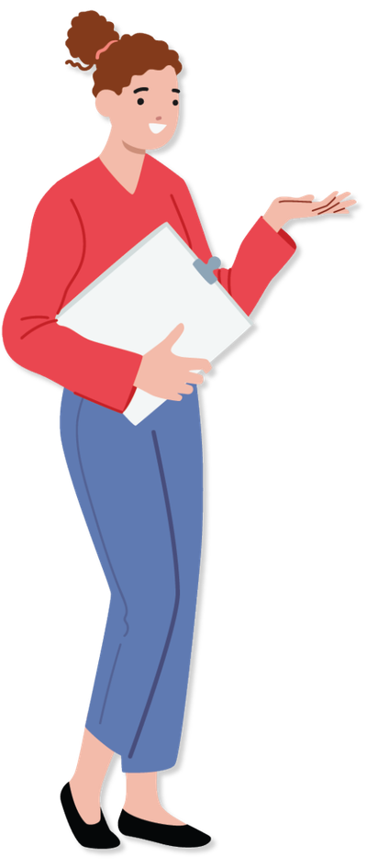
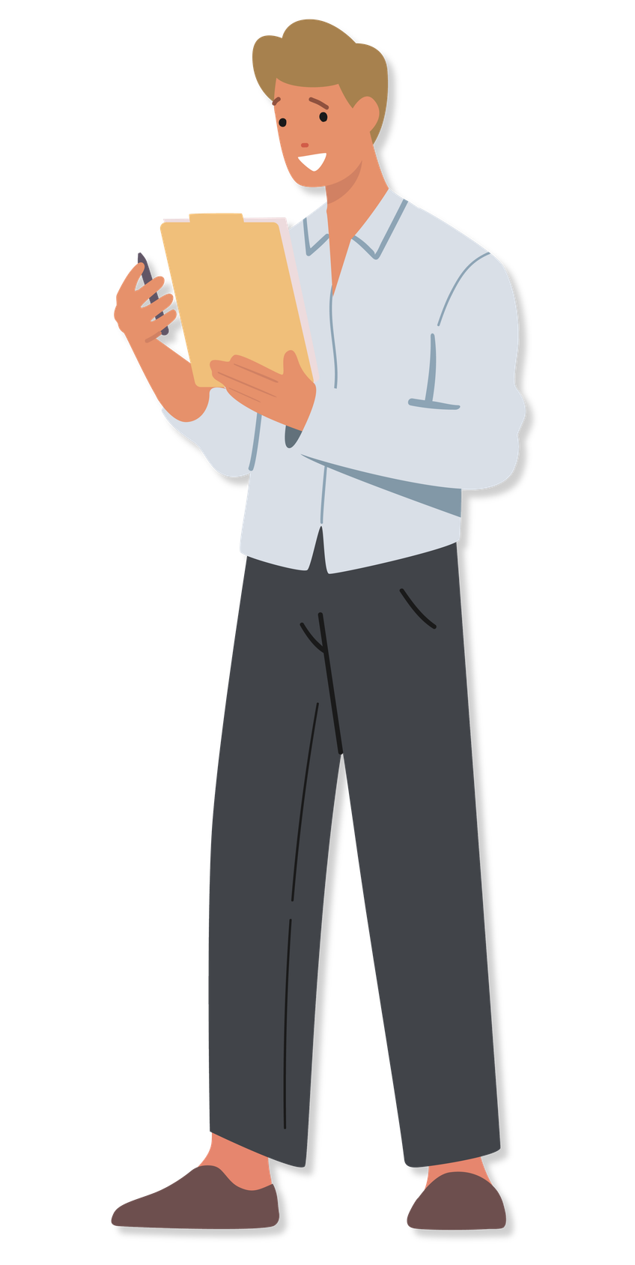
Checking Our
Work
Notes:
SOCIAL COPY
The work doesn't end on Election Day. Officials take a close look at election processes before, during, and after each election.
For more information, check: [Insert link]
ALT TEXT
A light blue background with an illustration of a woman using red binoculars,
dressed in a blue dress. To the left of the illustration, the text reads, ‘Election Audits’ with ‘Election’ in blue and ‘Audits’ in red with a red
underline.

Slide 3

OBSERVE THE AUDIT
See how results are checked
Watch the process up close
Open to the public
Notes:
SOCIAL COPY
The work doesn't end on Election Day. Officials take a close look at election processes before, during, and after each election.
For more information, check: [Insert link]
ALT TEXT
A light blue background with an illustration of a woman using red binoculars,
dressed in a blue dress. To the left of the illustration, the text reads, ‘Election Audits’ with ‘Election’ in blue and ‘Audits’ in red with a red
underline.

Slide 4
OBSERVE THE AUDIT
Open to the public
[Date & Time]
[Office/Location]
Notes:
SOCIAL COPY
The work doesn't end on Election Day. Officials take a close look at election processes before, during, and after each election.
For more information, check: [Insert link]
ALT TEXT
A light blue background with an illustration of a woman using red binoculars,
dressed in a blue dress. To the left of the illustration, the text reads, ‘Election Audits’ with ‘Election’ in blue and ‘Audits’ in red with a red
underline.

Slide 5

ELECTION
AUDITS
Notes:
SOCIAL COPY
The work doesn't end on Election Day. Officials take a close look at election processes before, during, and after each election.
For more information, check: [Insert link]
ALT TEXT
A light blue background with an illustration of a woman using red binoculars,
dressed in a blue dress. To the left of the illustration, the text reads, ‘Election Audits’ with ‘Election’ in blue and ‘Audits’ in red with a red
underline.

Slide 6




What Happens During an Election Audit?
Auditors check seals and serial numbers.
Auditors compare results to paper records.
Auditors investigate any discrepancies.
Auditors document and report audit results.

Slide 7
What Happens During an Election Audit?
Auditors check seals and serial numbers.

Slide 8
What Happens During an Election Audit?
Auditors compare results to paper records.

Slide 9
What Happens During an Election Audit?
Auditors investigate any discrepancies.

Slide 10
What Happens During an Election Audit?
Auditors document and report audit results.

Slide 11


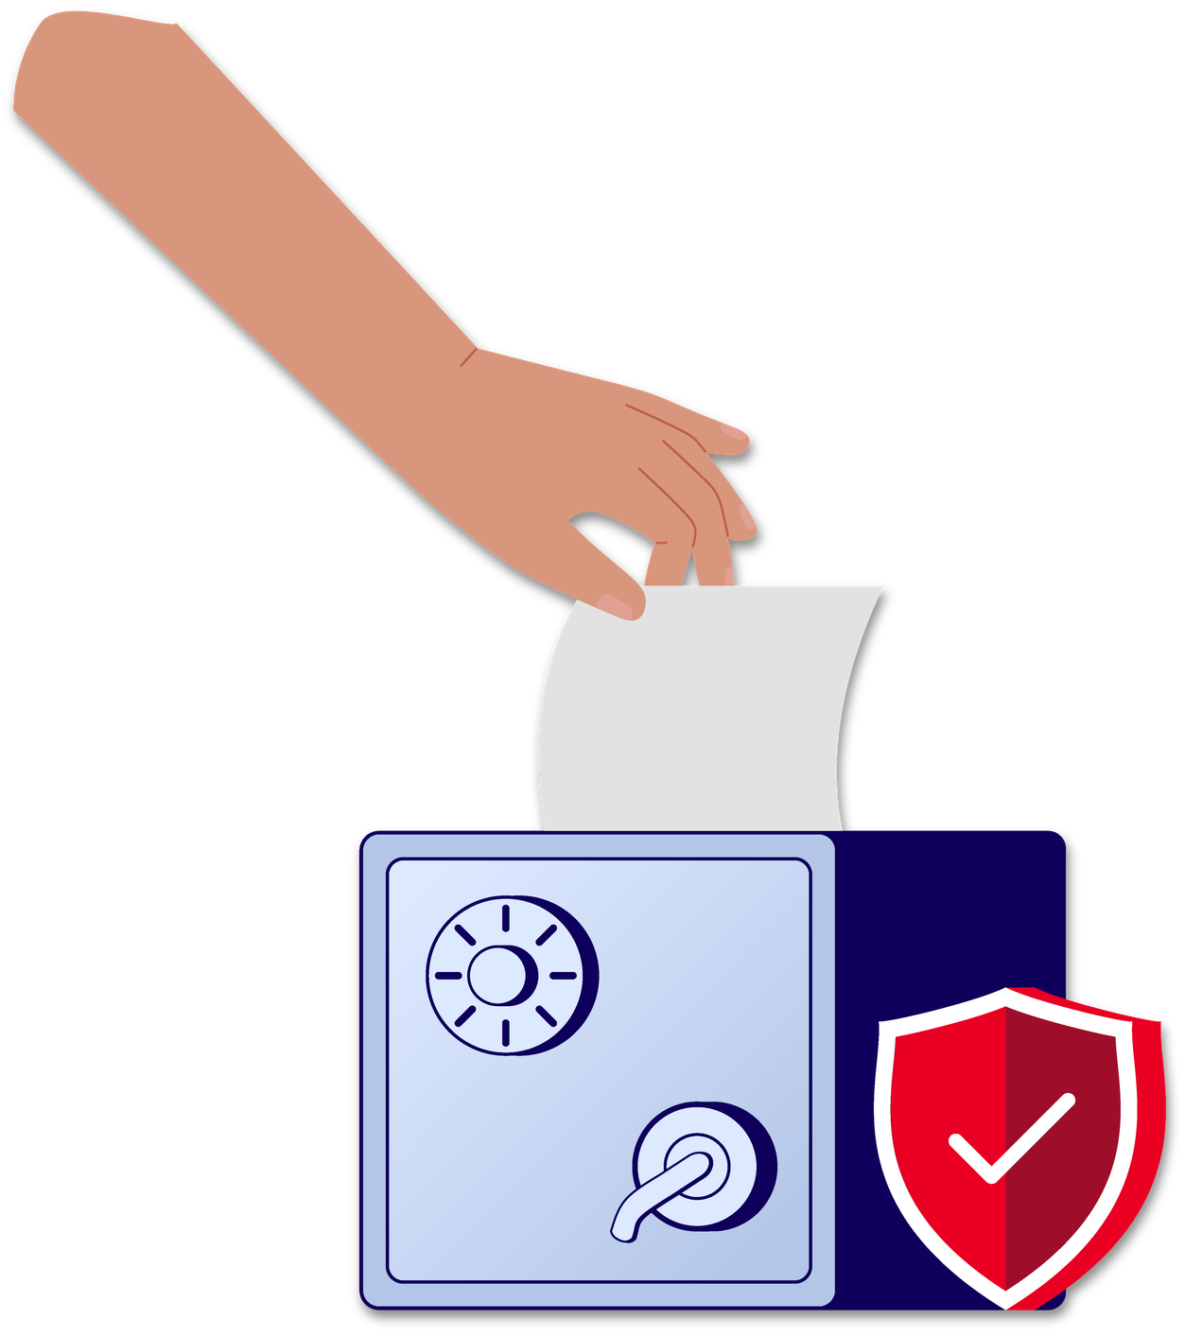
Secure
Elections
Notes:
Ensuring the integrity of our elections is a top priority. 🗳
Learn more about the security measures in place to safeguard your vote: www.
eac.gov/voters/election-security
ALT TEXT
A white background with an illustration of a hand putting a ballot into a safe
with a red shield symbol next to it, mimicking a ballot box. The text above the
illustration reads, ‘Secure elections.’

Slide 12

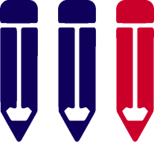
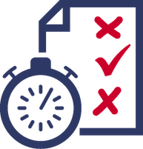

Prepare
Testing
&
Test
Auditing
Review
Notes:
SOCIAL COPY
Part of election day preparation is completing testing for each
voting machine. After the election, these results are compared to our paper records. 🗳✅
Learn more at [LINK]
ALT TEXT
A graphic titled ‘Testing and Auditing’ displaying a three-step process:
‘Prepare’ with an icon of three pencils, ‘Test’ with a piece of paper with x’s and a
checkmark, suggesting a test, and ‘Review’ with a check mark icon.

Slide 13




ELECTION AUDIT
Election officials randomly
select ballots to audit.
The ballots are hand counted and the vote totals are compared to the machine counted vote totals.
Any discrepancies are investigated.
Audit results are documented and reported.
AUDIT
COMPLETE
Notes:
SOCIAL COPY
Post-election audits are crucial for maintaining integrity, ensuring accuracy, and
promoting transparency of our elections.
Learn more about the process:
www.eac.gov/election-officials/election-audits-across-united-states
ALT TEXT
Graphic with a blue background. The text at the top reads, ‘Election officials
randomly select ballots to audit. The ballots are hand counted and the vote
totals are compared to the machine counted vote totals. Any discrepancies are
investigated. Audit results are documented and reported. Audit complete.’

Slide 14
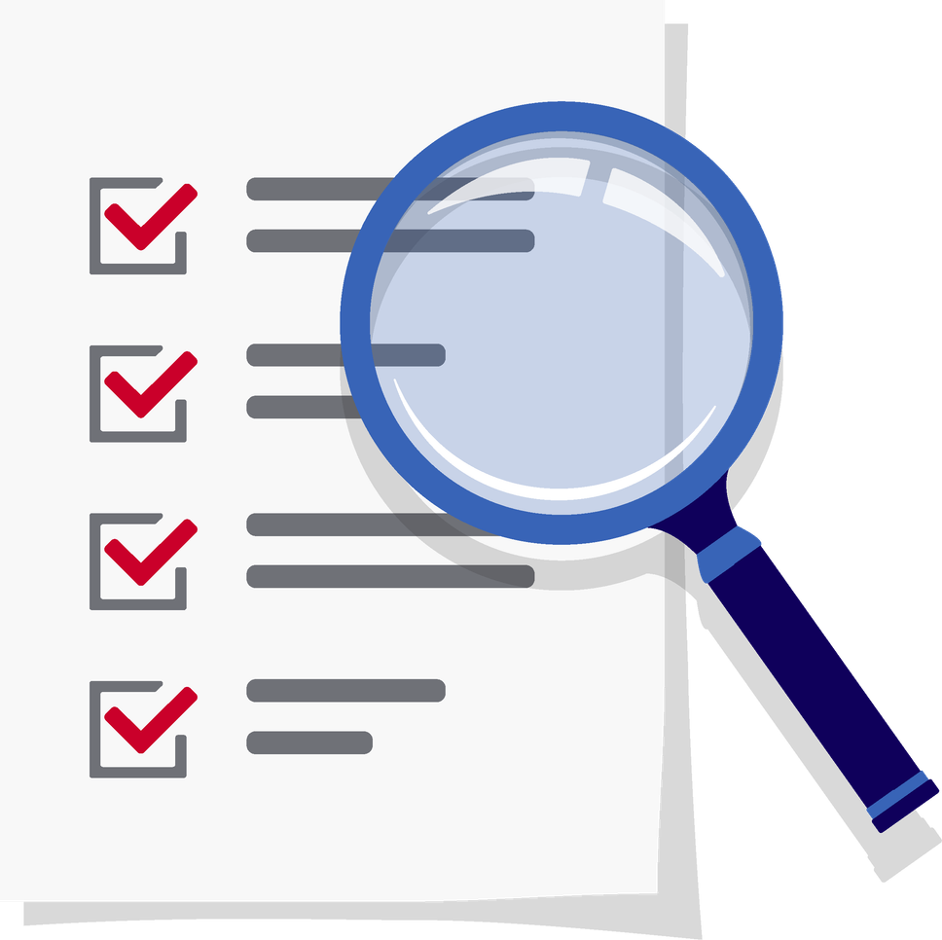
What is a
post-election audit?
Notes:
SOCIAL COPY
Curious about election audits? 🧐 An election audit is a detailed review of
procedures, results, and equipment to ensure accuracy and integrity.
Learn more at: www.eac.gov/election-officials/election-audits-across-united-states
ALT TEXT
An illustrative image featuring a magnifying glass focusing on a document with
check marks, accompanied by the question “What is a post-election audit?” set
against a blue background.

Slide 15
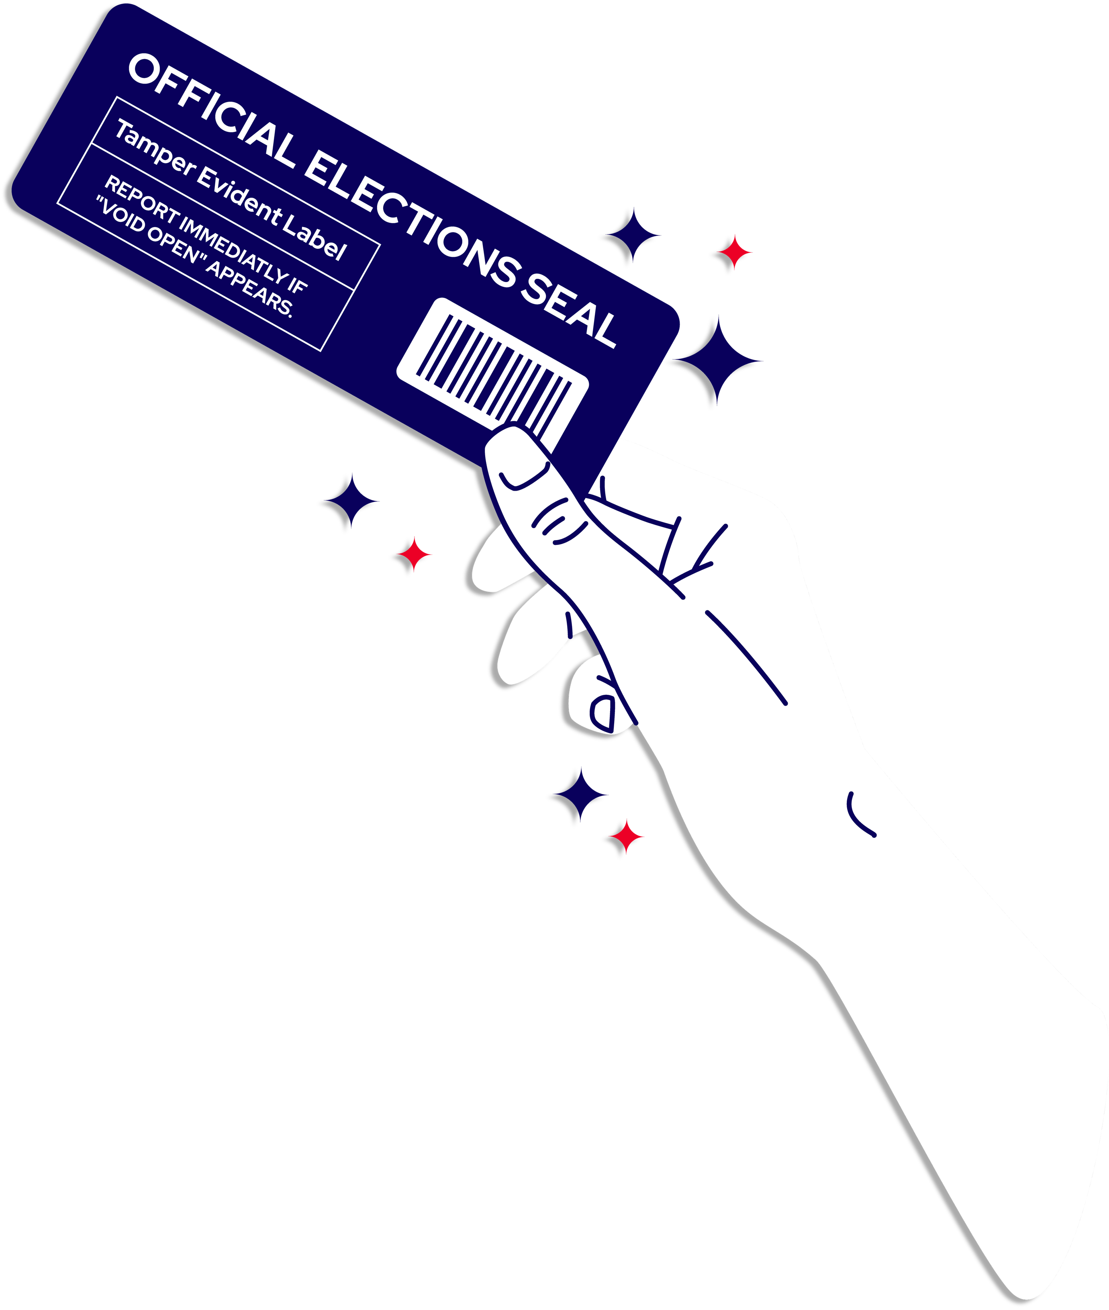
Votes
are secured
at every stage
of the process.
Notes:
SOCIAL COPY
Election officials secure voting systems at every stage of the process, including
using tamper evident seals.
Learn more about how election officials secure voting systems at every stage of
the process, [link].
ALT TEXT
A hand holds a dark blue “Official Elections Seal” with a barcode and a “Tamper
Evident Label.” The headline reads: “Votes are secured at every stage of the
process.”

Slide 16
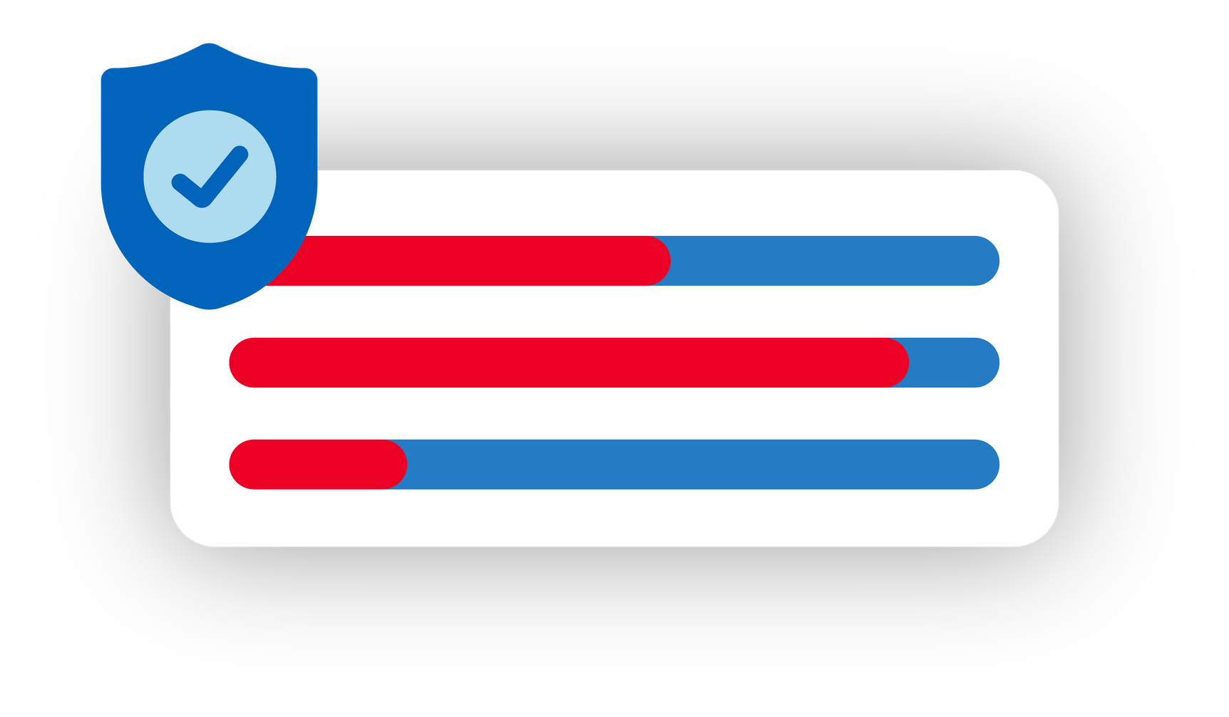
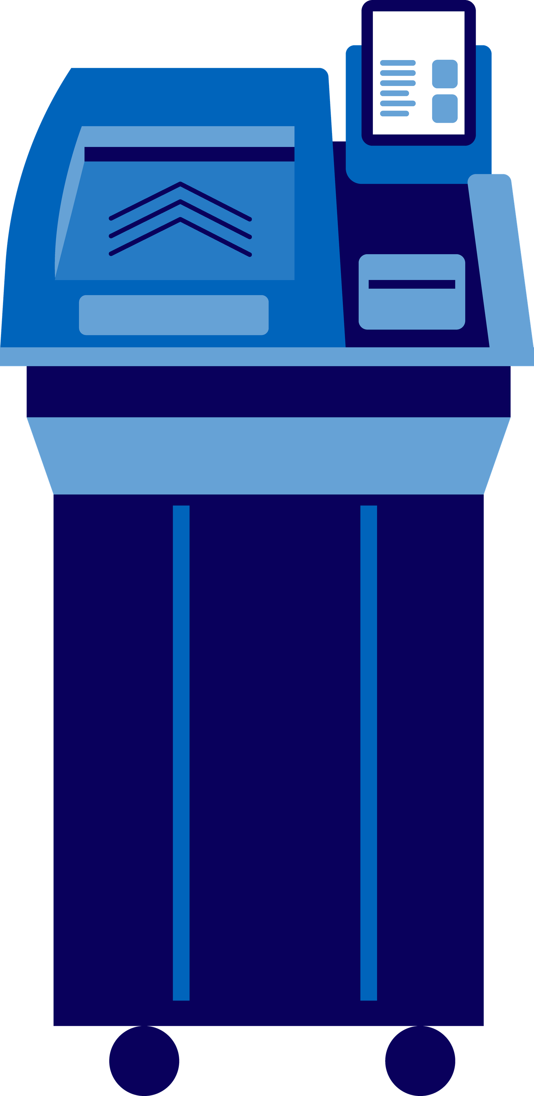
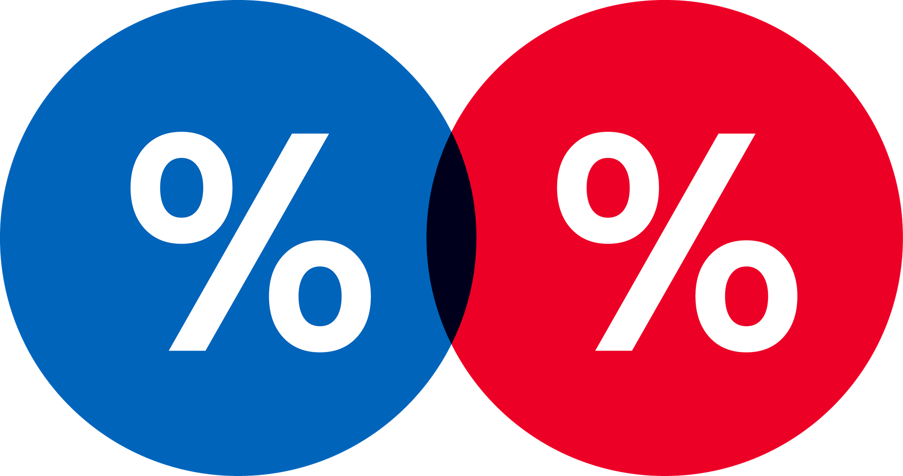
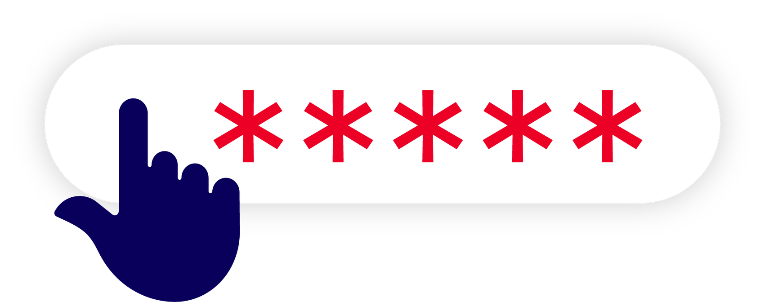
Did you
know?
Notes:
SOCIAL COPY
Did you know?
After each election, election results are thoroughly audited. We compare election results to paper records to ensure ballots were counted correctly.
Learn more about the types of security measures in place to safeguard your
vote, [LINK]
ALT TEXT
Illustration of a blue voting machine with a ballot being inserted. A shield icon
with a checkmark appears beside security progress bars, and a password field
with hidden characters. Two overlapping circles with percentage symbols are
displayed above. Text at the bottom reads, “Did you know?”

