Slide 1
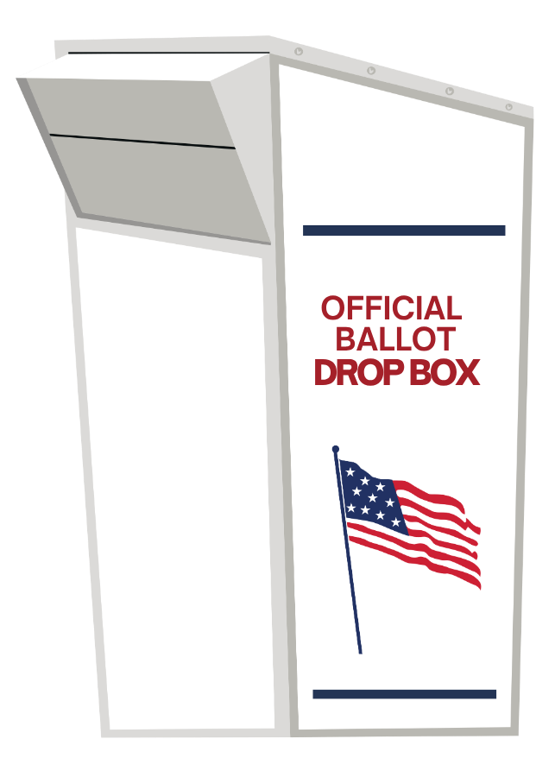

Return your
ballot
Your ballot must be received by
Tuesday, November 3rd

Slide 2
Return your
ballot
Drop off your ballot today!

Slide 3
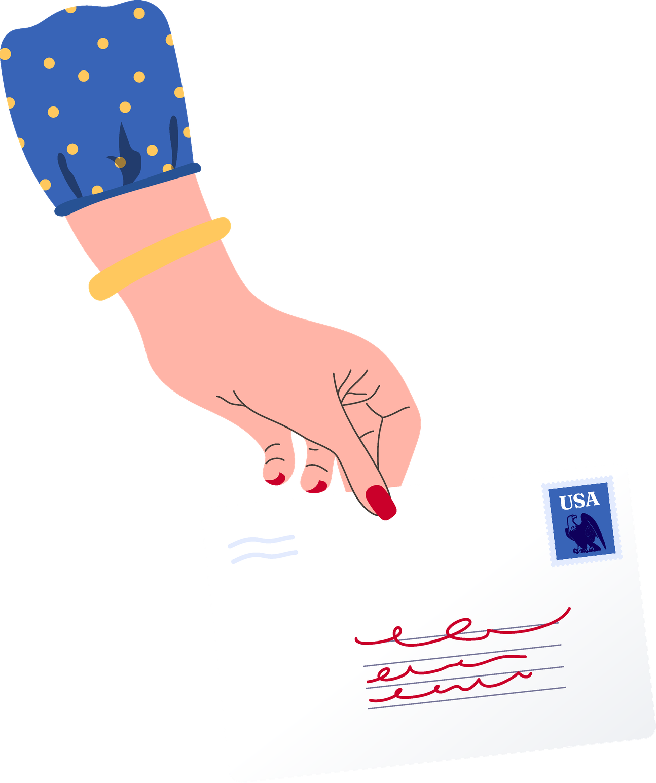

Make your (post)mark.
Postmark
your ballot by
Tuesday, November 3rd

Slide 4


Sign. Seal.
Send.
Return your mail ballot today!

Slide 5
Time to return your ballot!

Slide 6


The early bird gets the ballot.

Slide 7



01
Request
your mail ballot
Voting
by mail?
02
Receive
your mail ballot
03
Fill Out
your mail ballot
04
Return
your mail ballot
05
US POSTAGE
Confirm
your mail ballot

Slide 8


Return your mail ballot today

Slide 9


Mail it in.
Drop it off.
Walk it up.
Just vote it.

Slide 10
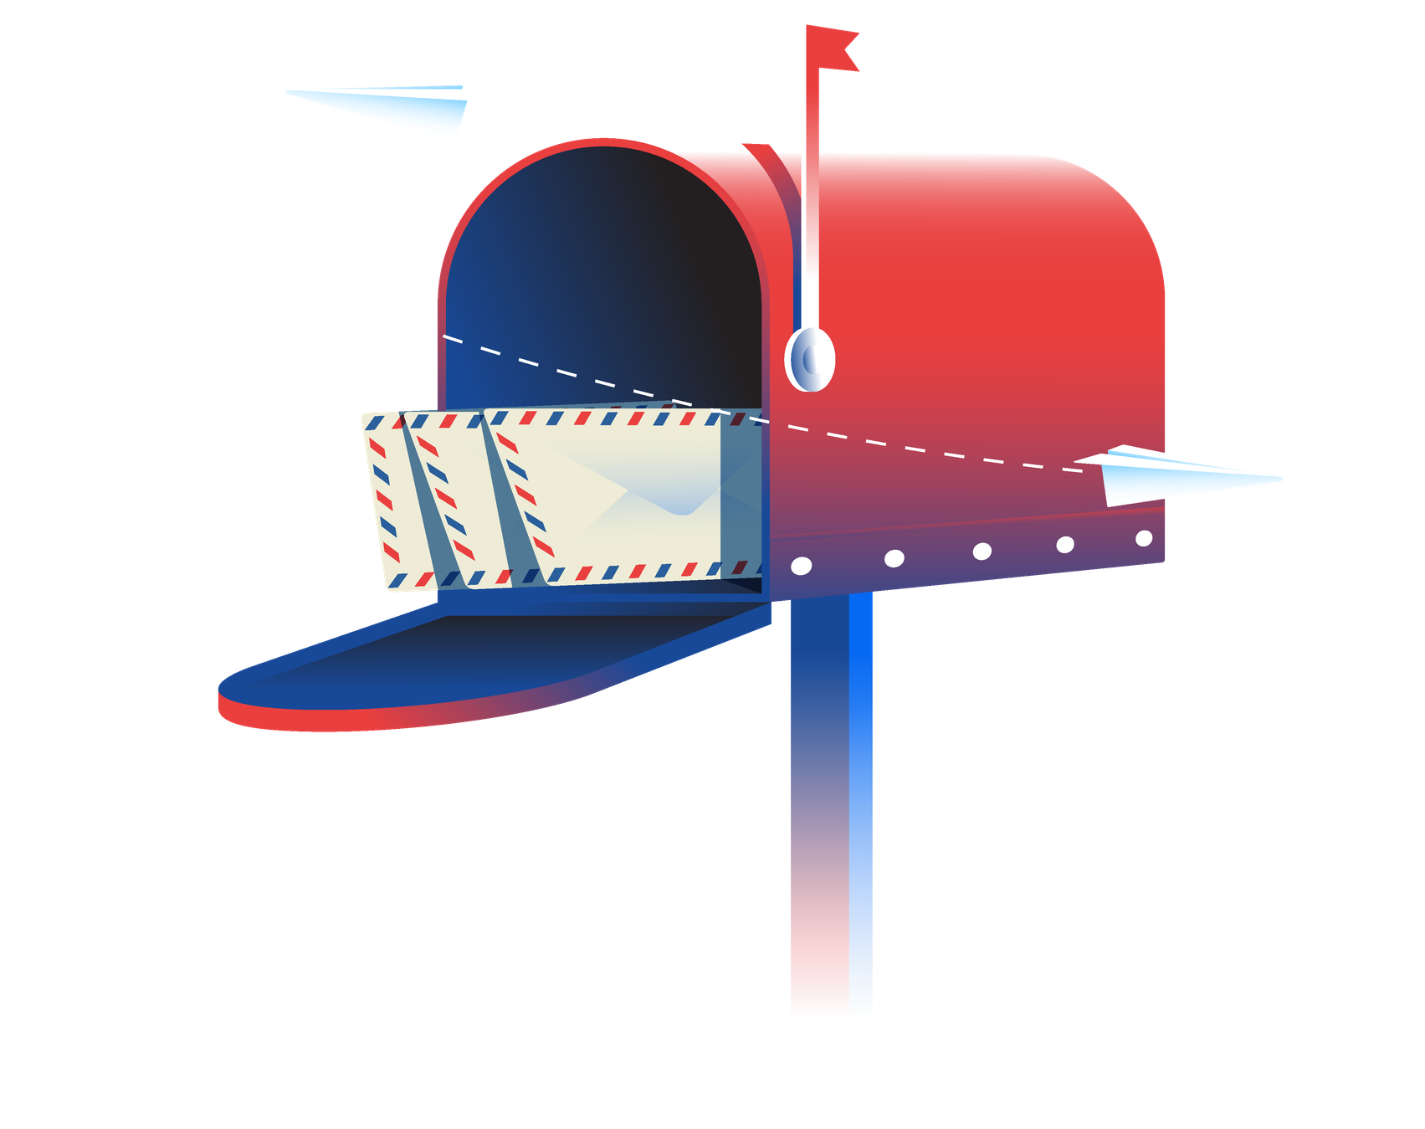
Return your absentee ballot today!

Slide 11






Time to
return Your
Ballot

Slide 12


Raise red flags
(in a good way)
Return your ballot today!

