Slide 1
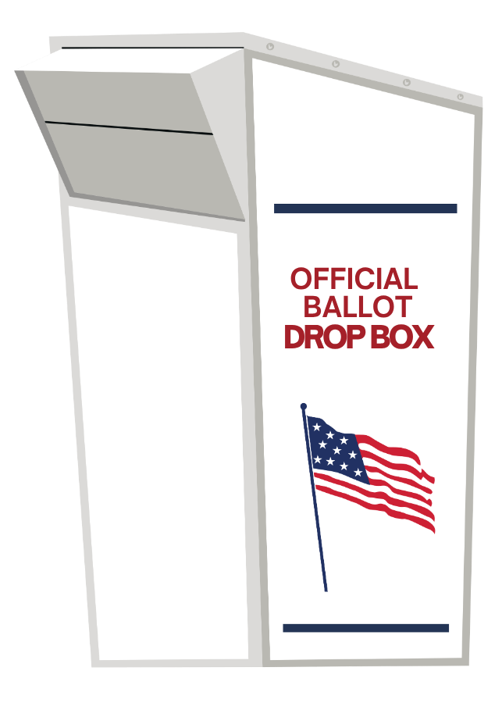

Return
your
ballot
Your ballot must be received by
Tuesday, November 3rd

Slide 2
Return
your
ballot
Drop off
your ballot today!

Slide 3
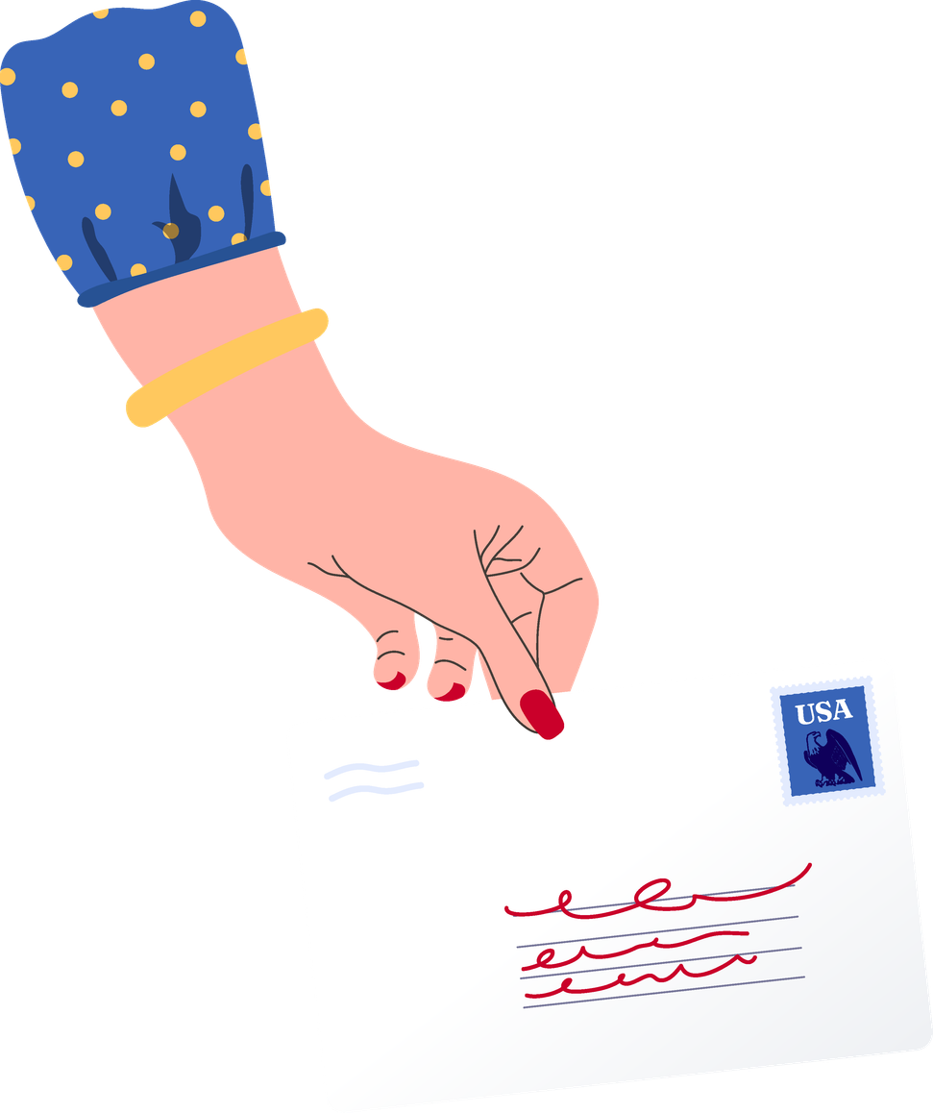

Make your (post)mark.
Postmark
your ballot by
Tuesday,
November 3rd

Slide 4


Sign.
Seal.
Send.
Return your mail ballot today!

Slide 5
Time to return your ballot!

Slide 6



Voting
by mail?
US POSTAGE
01
02
Request
your mail ballot
Receive
your mail ballot
03
04
Fill Out
your mail ballot
Return
your mail ballot
05
Confirm
your mail ballot

Slide 7


The early bird gets the ballot.

Slide 8


Return your
mail ballot today

Slide 9


Mail it in.
Drop it off.
Walk it up.
Just vote it.

Slide 10
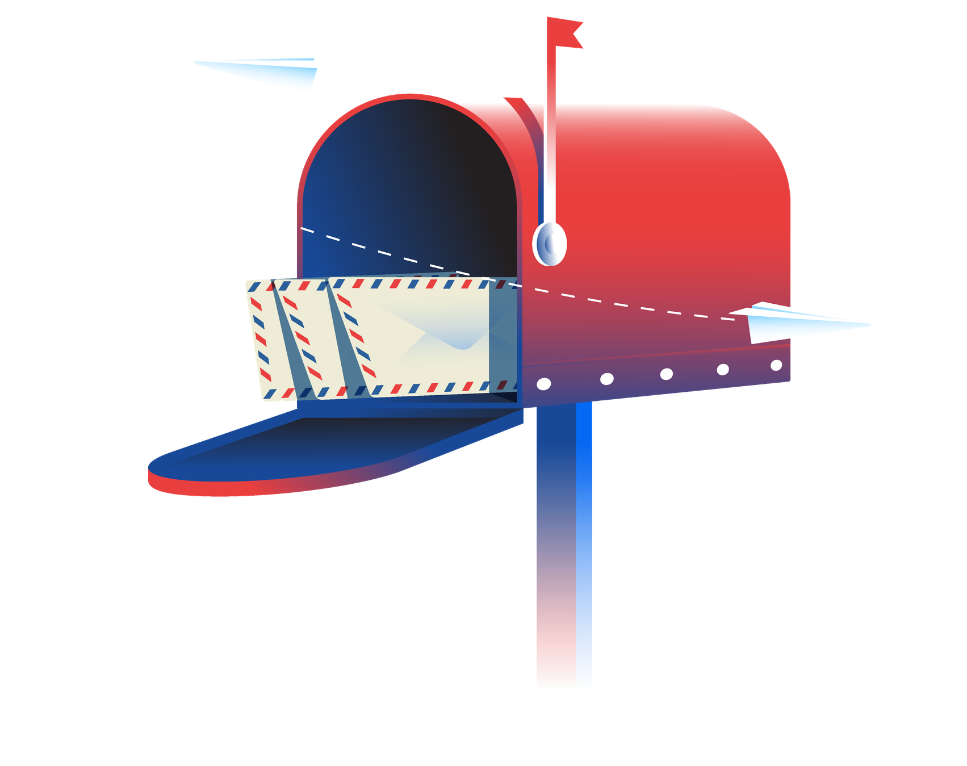
Return your absentee ballot today!

Slide 11





Time to
return Your
Ballot

Slide 12


Raise red flags
(in a good way)
Return your
ballot today!

