Slide 1








Help America Vote
Apply to be a poll worker.
Complete your training.
Help voters cast their ballot.
Get paid for the time you serve your community!

Slide 2





Be Election Ready
Help America Vote
Check registration deadlines.
Register or update your information.
Find your polling place.
Check mailing deadlines.

Slide 3
Be Election Ready
Help America Vote

Slide 4









Be Election Ready
Help America Vote

Slide 5








Be Election Ready
Help America Vote

Slide 6






Be Election Ready
Help America Vote

Slide 7



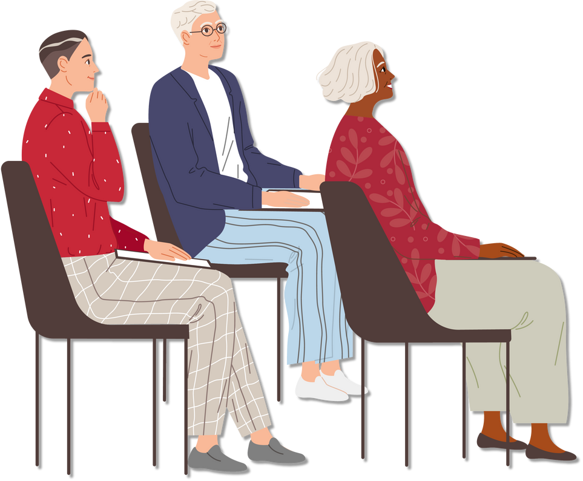

Be Election Ready
Poll Worker
Training

Slide 8



Help America Vote

Slide 9


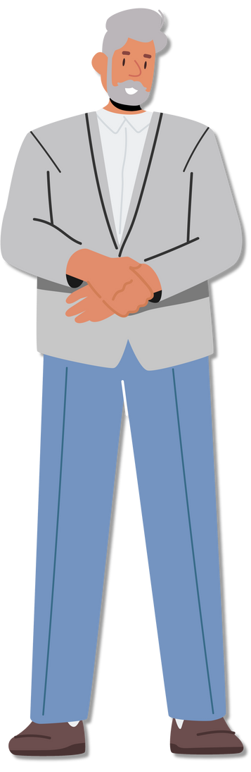

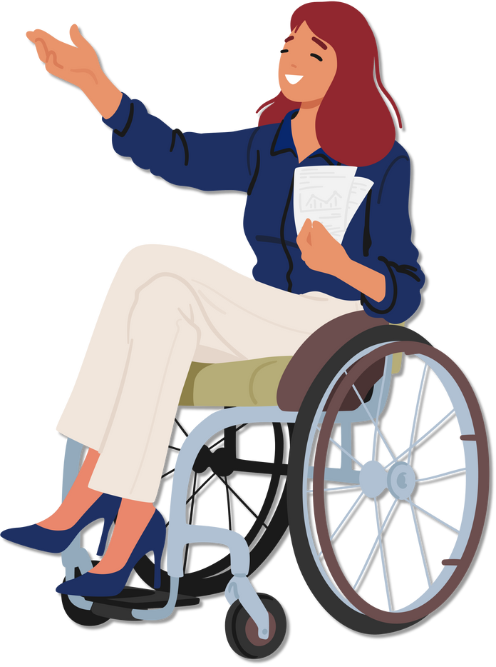
Be Election Ready
Help America Vote

Slide 10



Be Election Ready
Help America Vote

Slide 11
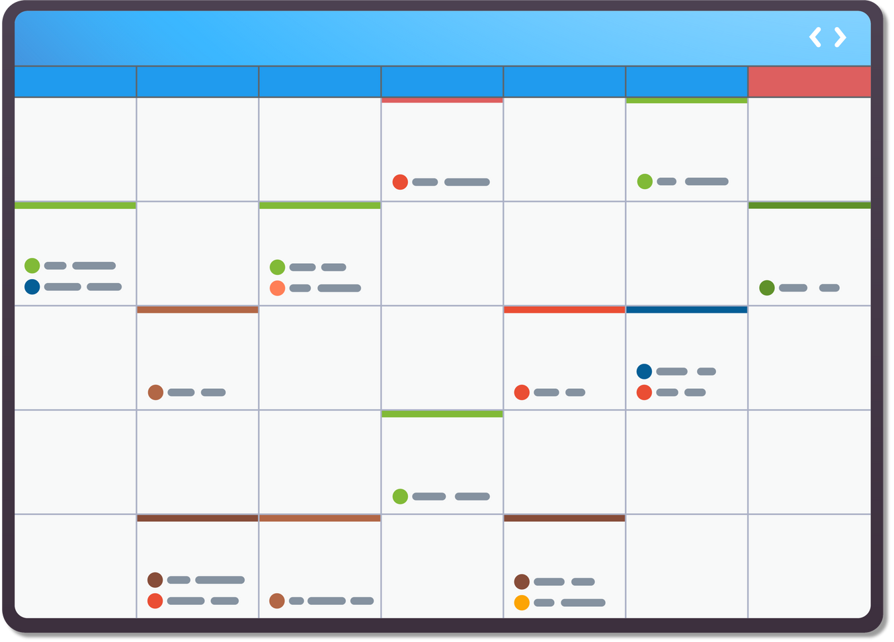

Be Election Ready
Help America Vote

Slide 12

Be Election Ready
Help America Vote

Slide 13
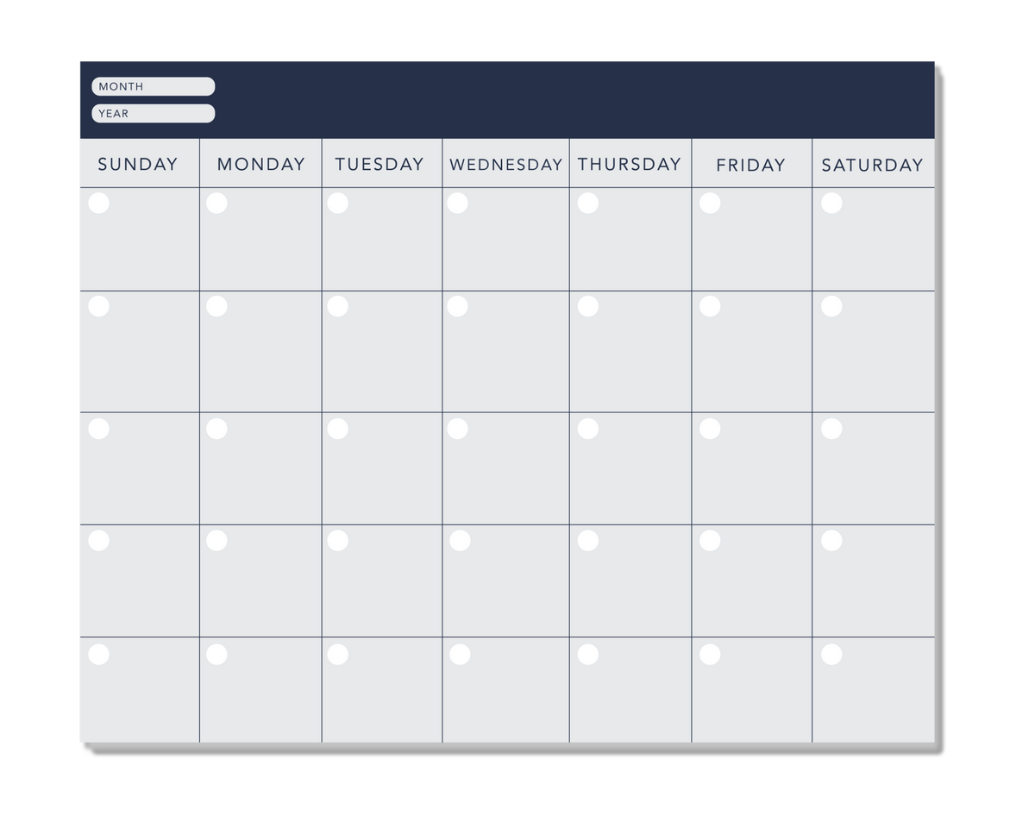

Be Election Ready
Help America Vote
Election Day!

Slide 14
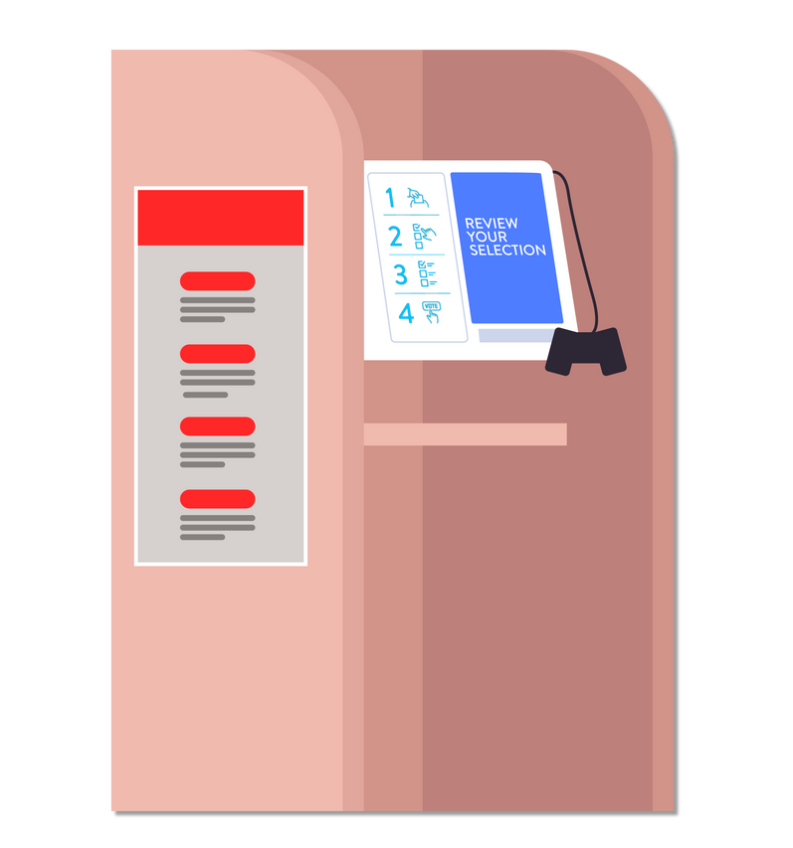
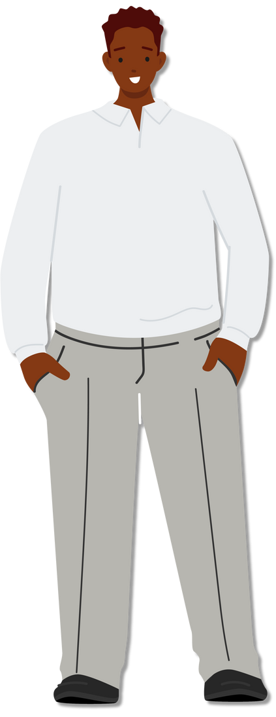

Be Election Ready
Help America Vote

Slide 15


Be Election Ready
Help America Vote

Slide 16

Be Election Ready
Help America Vote

