Slide 1
FACA Membership Overview
April 2025

Slide 2
Relevant Federal Laws and Regulations
Federal Advisory Committee Act (FACA)
Government in the Sunshine Act (5 U.S.C. § 552b)
Freedom of Information Act (FOIA) (5 U.S.C. 552)
Privacy Act (5 U.S.C. § 552a)

Slide 3
Board Member Duties and Responsibilities
Participate in meetings.
Submit non-binding advice and recommendations to the EAC.
Follow EAC approved charter for the FACA Board and FACA.
Comport yourself with integrity and do not trade upon your position as a member of the EAC Advisory board for your own personal benefit.
Do not use your service as a representative on the board to promote yourself, your services/products or private parties.

Slide 4
Board Member Duties and Responsibilities
The law requires any permissible direct communications with Congress, in your official capacity as a board member, be made only through the official channels of the EAC.
These restrictions do not prohibit you from lobbying members of Congress or state legislatures, or urging others to do so, on your own time in your personal capacity.
If you lobby Congress or state legislatures in your personal capacity and the issue is related to EAC Board business, you should make clear that you are not representing an EAC advisory board and not acting in your official capacity as an Advisory Board member.

Slide 5
FACA Board Overview
April 2025

Slide 6
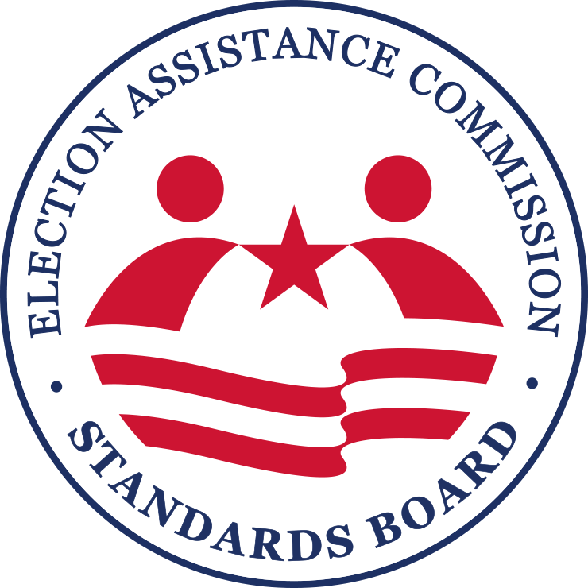
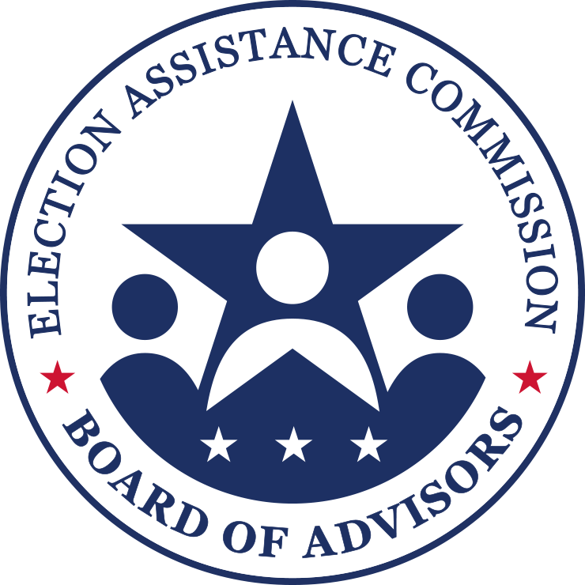
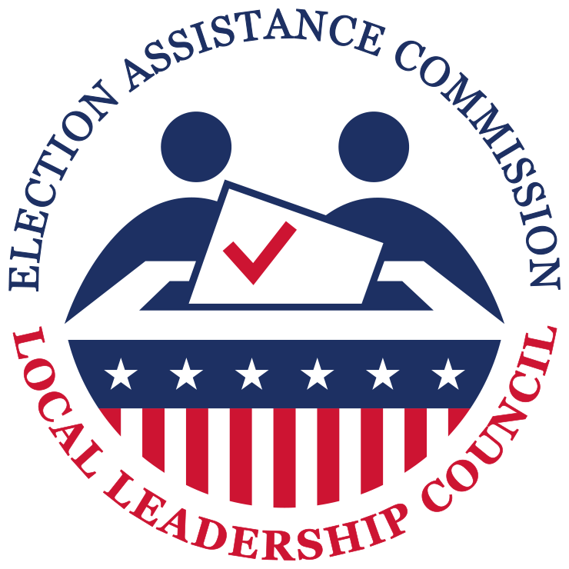
EAC Federal Advisory Committees

Slide 7
Technical Guidelines Development Committee
Chair: Director of NIST
Members: 2 Standards Board, 2 Board of Advisors, 1 ANSI, 2 ACCESSS Board, 1 IEEE, 2 NASED, 4 Technical Experts
Assists the Executive Director of the Commission in the development of the voluntary voting system guidelines.

Slide 8
Standards Board
55 state election officials selected by their respective chief state election official, and 55 local election officials selected through a process supervised by the chief state election official.
9-Member Executive Board
Advise EAC through review of the voluntary voting system guidelines described in Title II Part 3 of HAVA; through review of the voluntary guidance described under Title III of HAVA; and through the review of the best practices recommendations described in Section 241of Title II of HAVA, as required by HAVA or as may be developed by EAC.

Slide 9
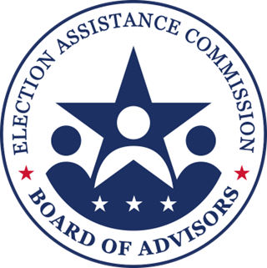
Board of Advisors
35-member board composed of representatives from the National Governors Association; National Conference of State Legislatures; National Association of Secretaries of State; The National Association of State Election Directors; National Association of Counties; the International Association of Government Officials; Election Center; International Association of Clerks, Recorders, Election Officials, and Treasurers; U.S. Commission on Civil Rights; and Architectural and Transportation Barriers Compliance Board.
Advise the EAC through review of (1) the voluntary voting system guidelines described in Title III Part 3 of the HAVA; (2) voluntary guidance described under Title III of HAVA; (3) best practices recommendations contained in the report submitted under Section 242(b) of Title II (HAVA Title II section 212); and (4) such documents that the EAC presents to the Board.

Slide 10
Local Leadership Council
2 members from each State local election official professional association
Only “discretionary” advisory committee for the EAC
Provide guidance and advice to the Election Assistance Commission on a variety of topics related to the administration of elections for federal office.

Slide 11
VVSG Process
EAC Executive Director must take into consideration any recommendations provided by the Technical Guidelines Development Committee
EAC Executive Director must submit the guidelines or modifications to both the Board of Advisors and the Standards Board, and both parties shall “review and submit comments and recommendations regarding the guideline (or modification) to the Commission.”
HAVA § 222(d) specifies that a guideline cannot be officially adopted unless the Board of Advisors and Standards Board have had a full ninety days to review the guidelines or modifications, and that the comments and recommendations they submit must be taken into consideration in the final adoption.
Final adoption requires approval of at least three Commissioners.
Final adoption of the voluntary voting system guidelines (or modification of such a guideline) shall be carried out by the Commission in a manner that provides for each of the following: (1) Publication of notice of the proposed guidelines in the Federal Register. (2) An opportunity for public comment on the proposed guidelines. (3) An opportunity for a public hearing on the record. (4) Publication of the final guidelines in the Federal Register.

Slide 12
NVRA Process
Consultation with the chief election officers of the States to prescribe regulations
11 CFR Part 9428 – current regs
Commission approval
Administrative Procedure Act (APA) notice-and-comment rule-making
Consultation with the chief election officers of the States to develop a mail voter registration application form for elections for Federal office
Commission Approval
Paperwork Reduction Act

Slide 13
Discussion of the Implementation of the Executive Order to Protect the Integrity of American Elections

