Slide 1

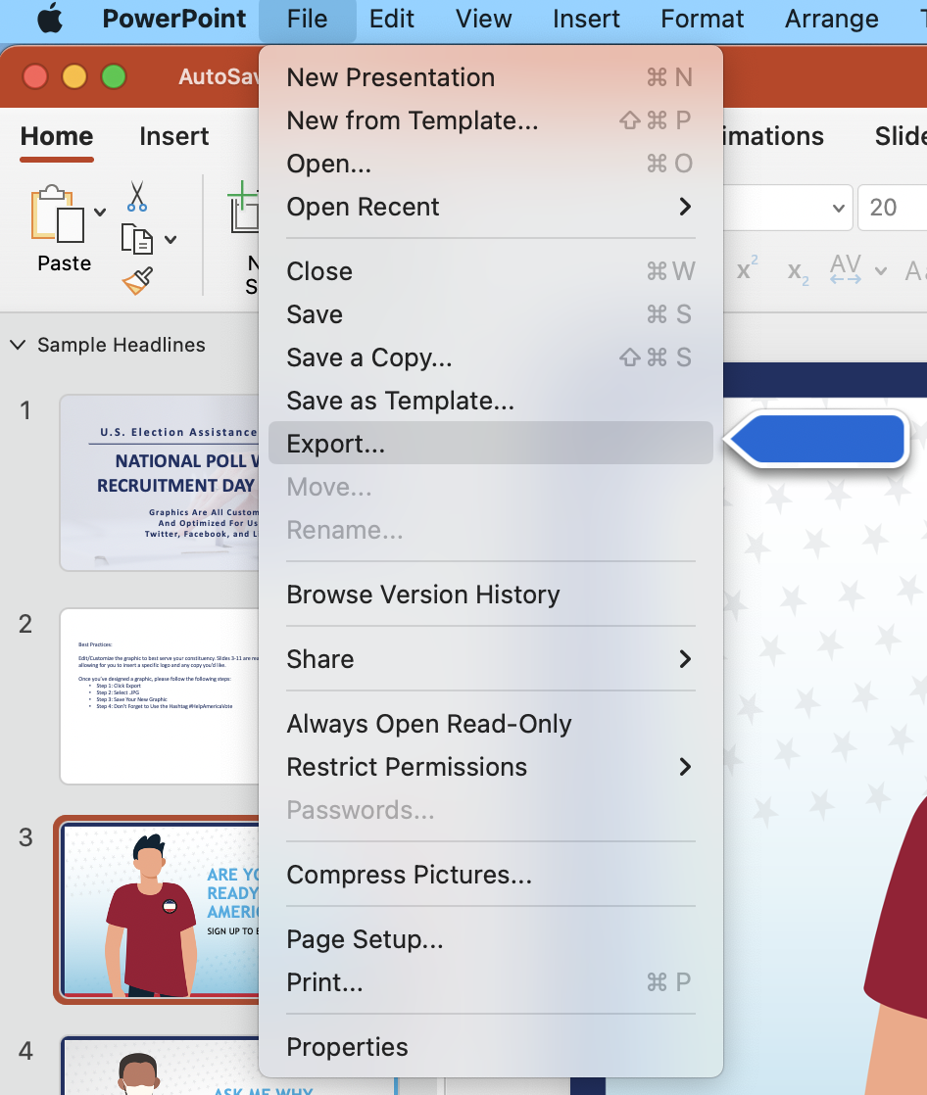
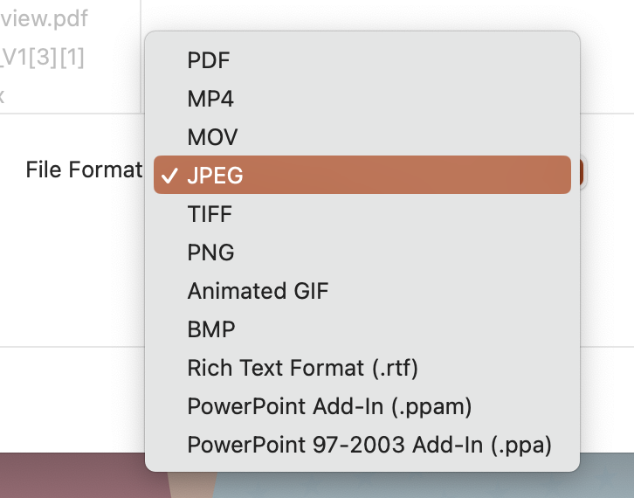
For Mac Users: Best Practices: Step-by-Step Guide To Customizable Graphics
Edit/Customize the graphic to best serve your constituency. There are two versions of each graphic, one that is ready to publish and one that is customizable – allowing for you to insert a specific logo and any copy you’d like.
Step 1
Step 2
Once you’ve designed a graphic, please follow the following steps:
Step 1: Click File, then Export
Step 2: Select .JPG
Step 3: Save Your New Graphic
Step 4: Don’t Forget to Use the Hashtag #HelpAmericaVote

Slide 2
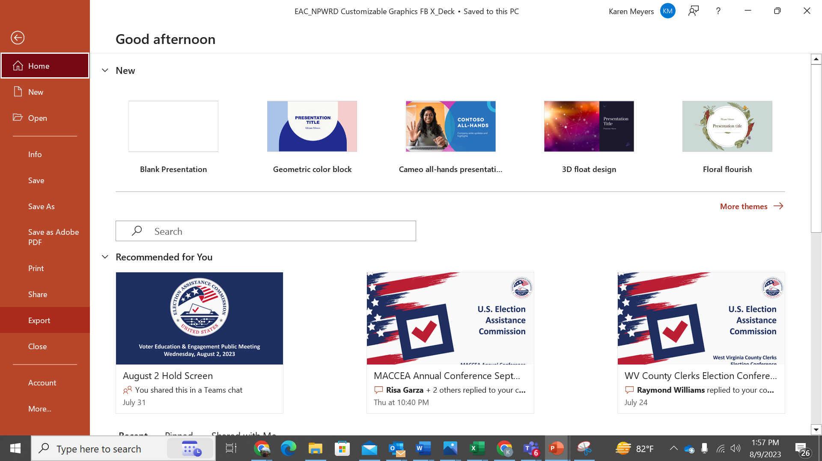
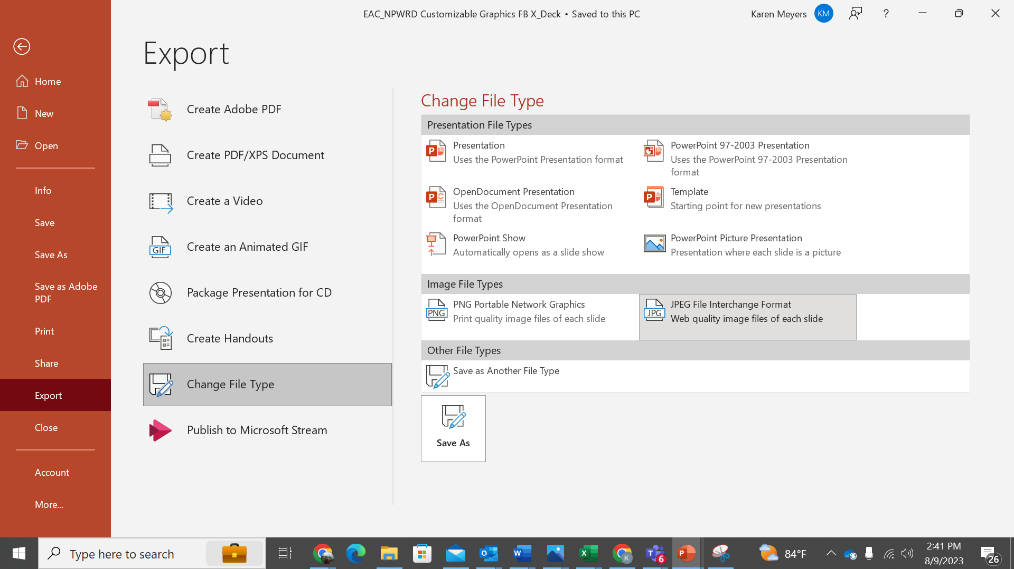
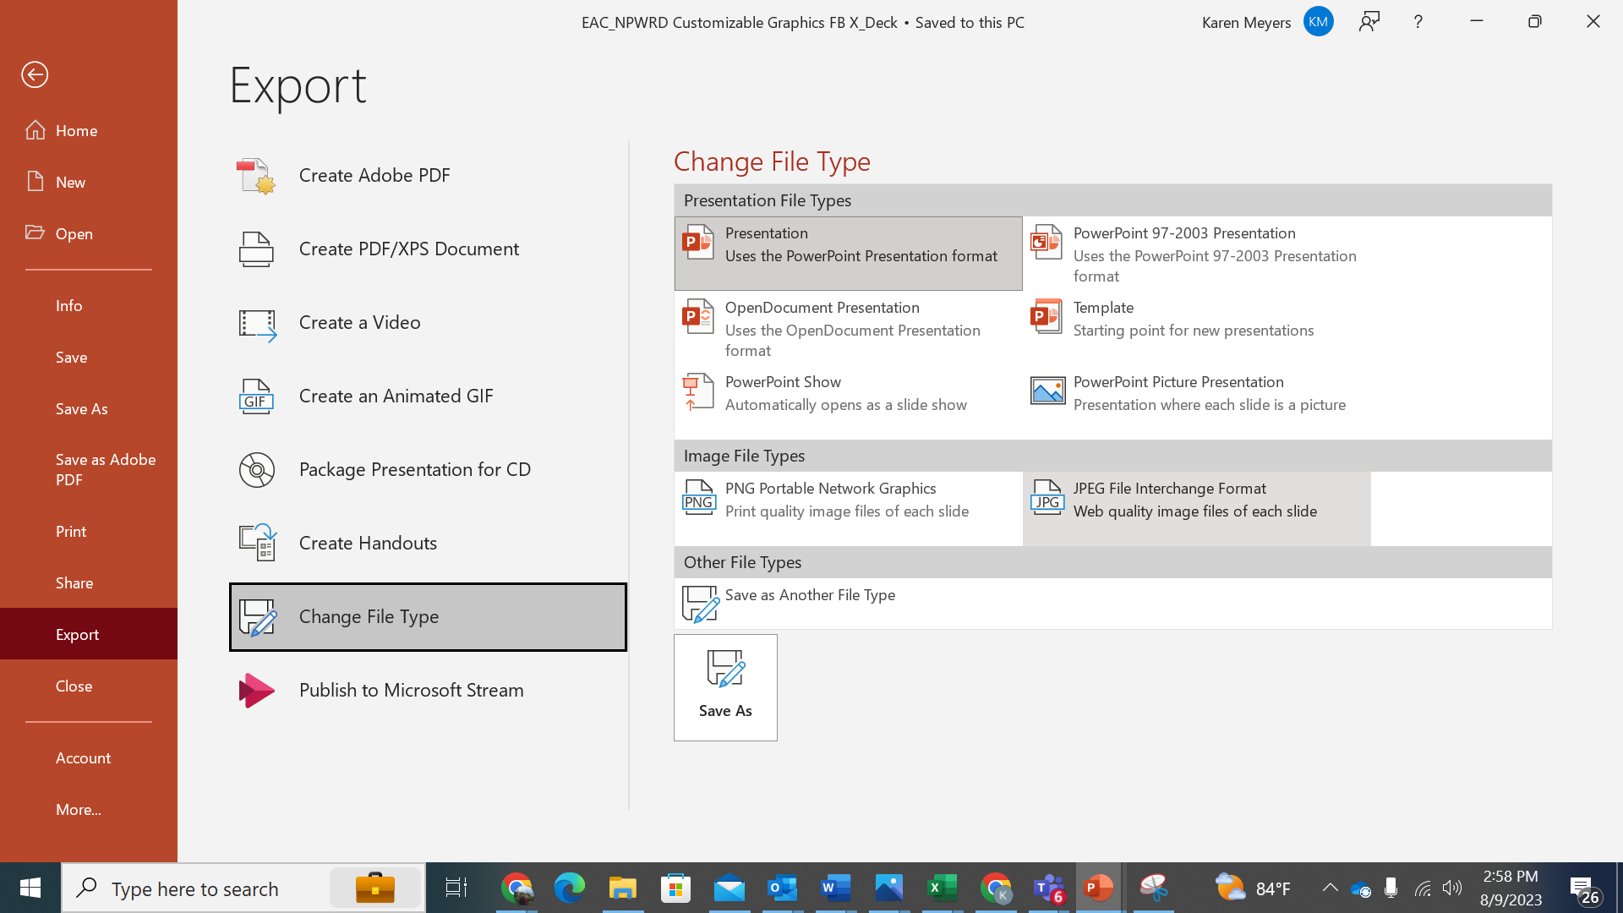
For Windows Users: Best Practices: Step-by-Step Guide To Customizable Graphics
Edit/Customize the graphic to best serve your constituency. There are two versions of each graphic, one that is ready to publish and one that is customizable – allowing for you to insert a specific logo and any copy you’d like.
Step 1
Step 2
Step 3
Once you’ve designed a graphic, please follow the following steps:
Step 1: Click File, then Export
Step 2: Click Change File Type
Step 3: Under Image File Types, Select .JPG
Step 4: Save Your New Graphic
Step 5: Don’t Forget to Use the Hashtag #HelpAmericaVote

Slide 3


Make it a resolution to Help America Vote!
Sign up to be an election worker!
To learn more visit helpamericavote.gov

Slide 4
Your Text Goes Here
Your Text Goes Here
Your Text Goes Here
Your Logo Goes Here

Slide 5

Make it a resolution to Help America Vote!
Sign up to be an election worker!
To learn more visit helpamericavote.gov

Slide 6
Your Text Goes Here
Your Subtext Goes Here
Your Subtext Goes Here
Your Logo Goes Here

Slide 7
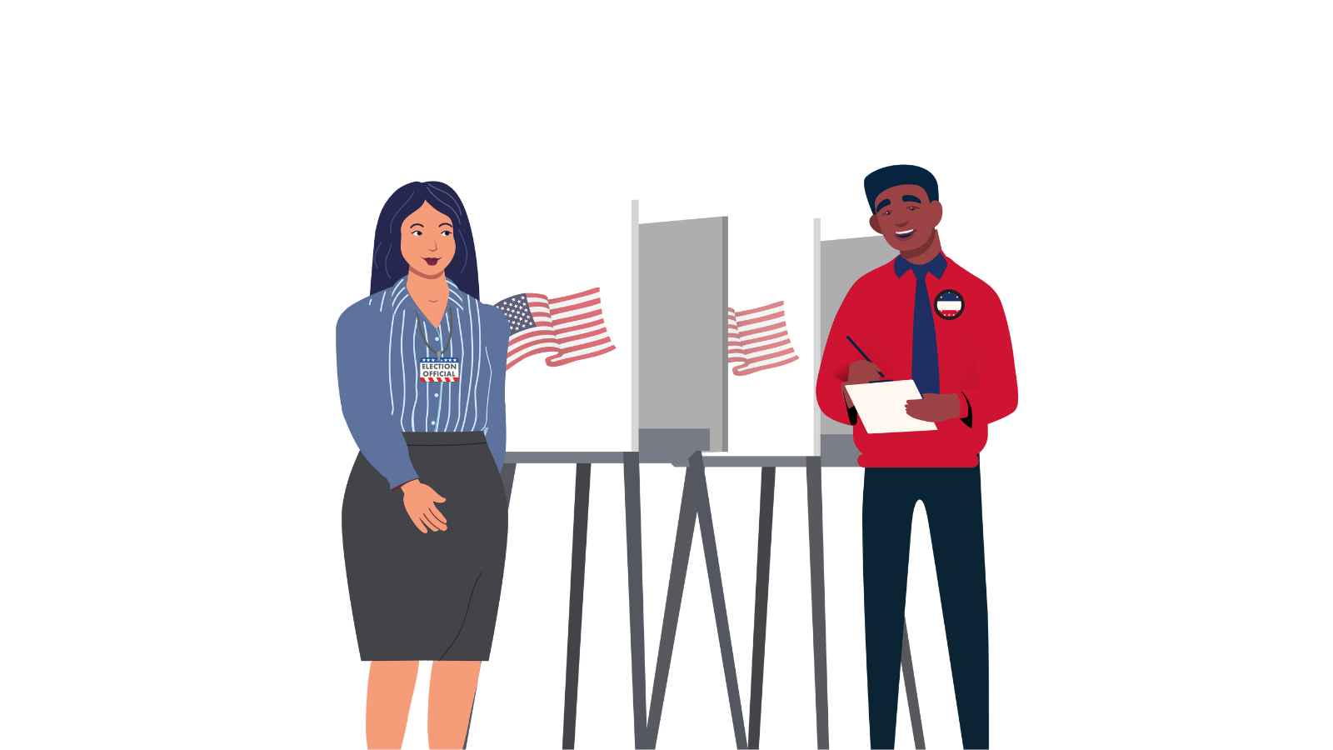
Make it a resolution to Help America Vote!
Sign up to be an election worker!
To learn more visit helpamericavote.gov

Slide 8
Your Text Goes Here
Your Subtext Goes Here
Your Subtext Goes Here
Your Logo Goes Here

Slide 9

Make it a resolution to
Help America Vote!
Sign up to be an election worker!
To learn more visit helpamericavote.gov

Slide 10
Your Text Goes Here
Your Subtext Goes Here
Your Subtext Goes Here
Your Logo Goes Here

Slide 11

Make it a resolution to Help America Vote!
Sign up to be an election worker!
To learn more visit helpamericavote.gov

Slide 12
Your Text Goes Here
Your Subtext Goes Here
Your Subtext Goes Here
Your Logo Goes Here

Slide 15


