Slide 1
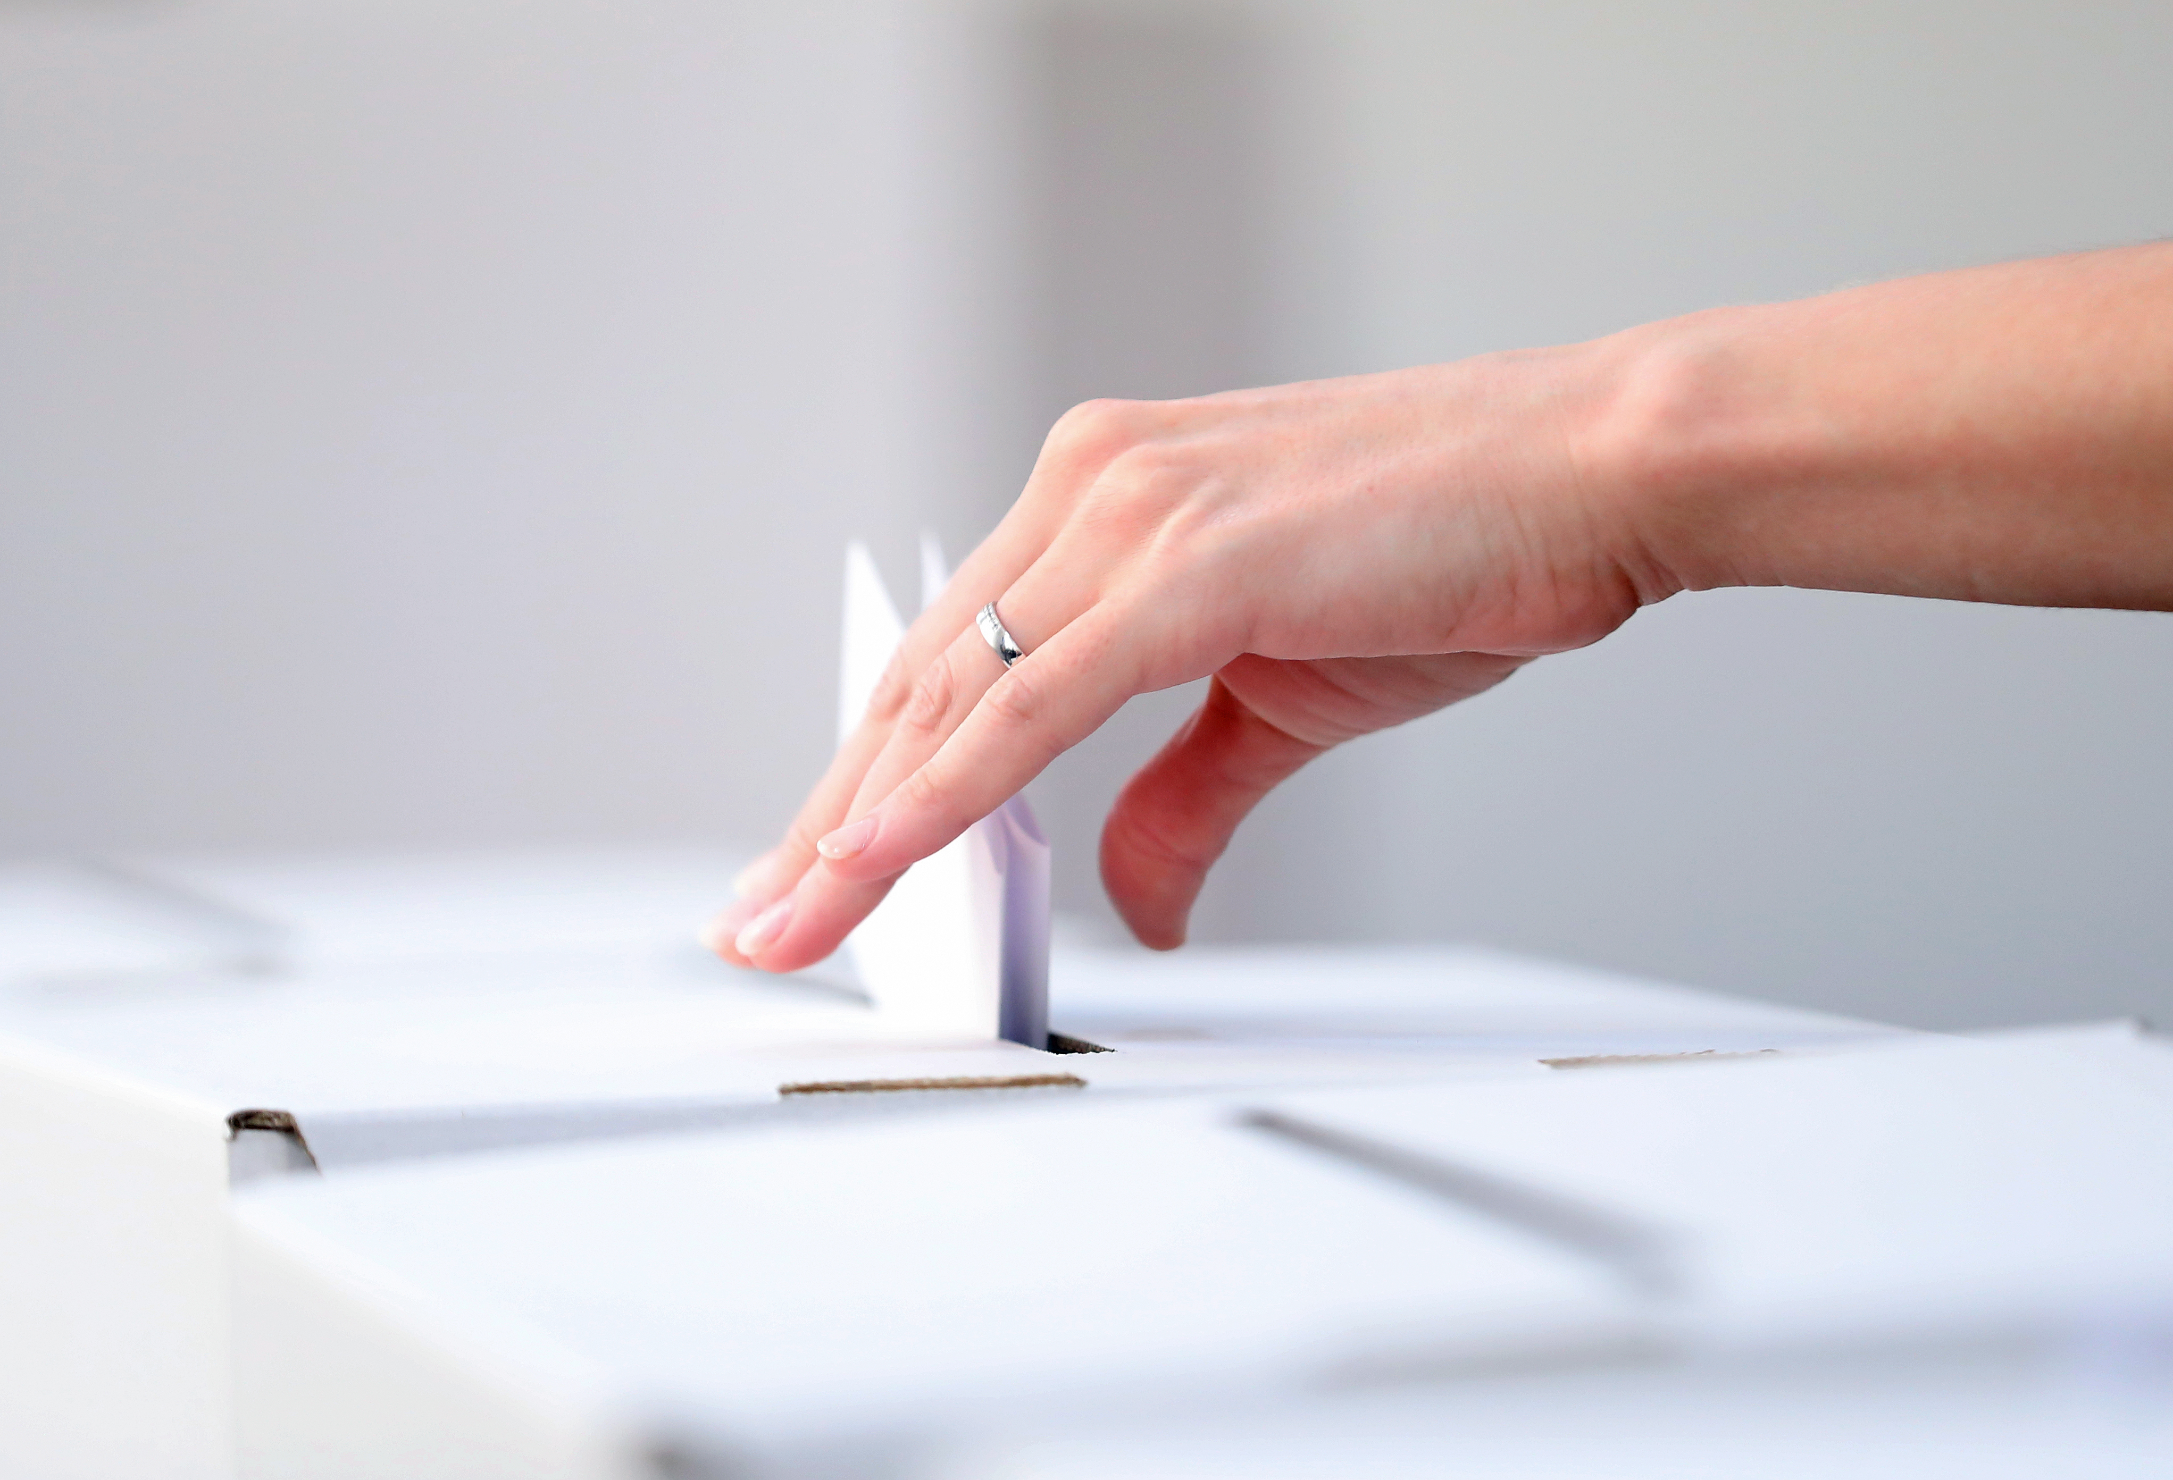
Election Assistance Commission
NATIONAL POLL WORKER RECRUITMENT DAY GRAPHICS
Graphics Are All Customizable And Optimized For Use on Instagram

Slide 2
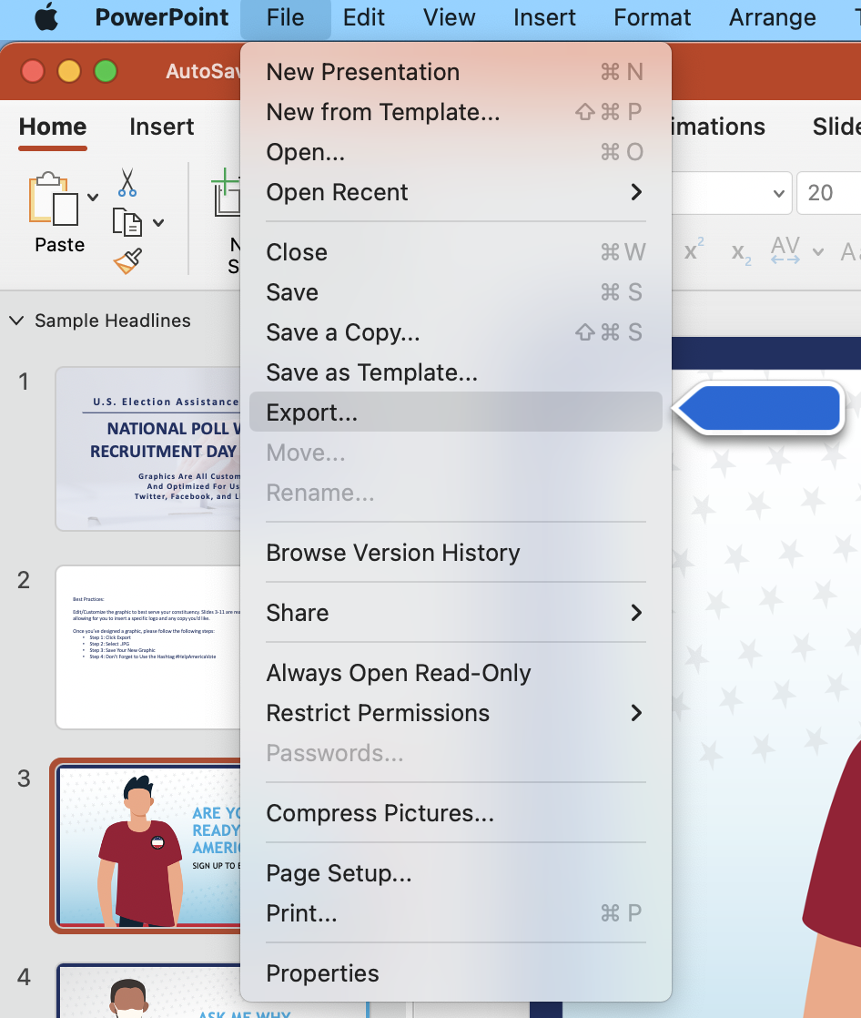
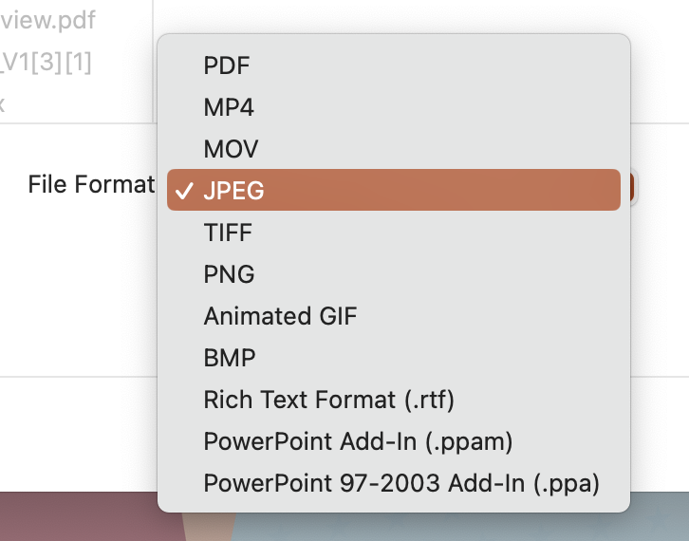
For Mac Users: Best Practices: Step-by-Step Guide To Customizable Graphics
Edit/Customize the graphic to best serve your constituency. Slides 3-11 are ready to publish graphics and slides 12-43 are customizable – allowing for you to insert a specific logo and any copy you’d like.
Once you’ve designed a graphic, please follow the following steps:
Step 1: Click File, then Export
Step 2: Select .JPG
Step 3: Save Your New Graphic
Step 4: Don’t Forget to Use the Hashtag #HelpAmericaVote
Step 1
Step 2

Slide 3
For Windows Users: Best Practices: Step-by-Step Guide To Customizable Graphics
Edit/Customize the graphic to best serve your constituency. Slides 3-11 are ready to publish graphics and slides 12-43 are customizable – allowing for you to insert a specific logo and any copy you’d like.
Once you’ve designed a graphic, please follow the following steps:
Step 1: Click File, then Export
Step 2: Click Change File Type
Step 3: Under Image File Types, Select .JPG
Step 4: Save Your New Graphic
Step 5: Don’t Forget to Use the Hashtag #HelpAmericaVote
Step 1
Step 2
Step 3

Slide 4
WANT TO GET MORE INVOLVED IN ELECTIONS?
SIGN UP TO BE A POLL WORKER

Slide 5
DID YOU KNOW MOST STATES PERMIT PEOPLE YOUNGER THAN 18 TO BECOME POLL WORKERS?
REACH OUT TO YOUR LOCAL ELECTION OFFICE TO LEARN MORE

Slide 6
ASK ME WHY I WORK IN ELECTIONS
SIGN UP TO BE A POLL WORKER

Slide 7
ACCURATE ELECTION INFORMATION COMES FROM TRUSTED SOURCES
REACH OUT TO YOUR STATE OR LOCAL ELECTION OFFICE TO LEARN MORE

Slide 8
I’M A POLL WORKER BECAUSE…
HELP AMERICA VOTE

Slide 9
INTERESTED IN LEARNING MORE ABOUT ELECTIONS?
SIGN UP TO BECOME A POLL WORKER

Slide 10
POLL WORKERS HELP AMERICA VOTE
REACH OUT TO YOUR LOCAL ELECTION OFFICE TO LEARN MORE

Slide 11
ARE YOU ELECTION READY? IS YOUR COMMUNITY?
HELP AMERICA VOTE DAY

Slide 12
ARE YOU ELECTION READY? IS YOUR COMMUNITY?
HELP AMERICA VOTE DAY

