Slide 1
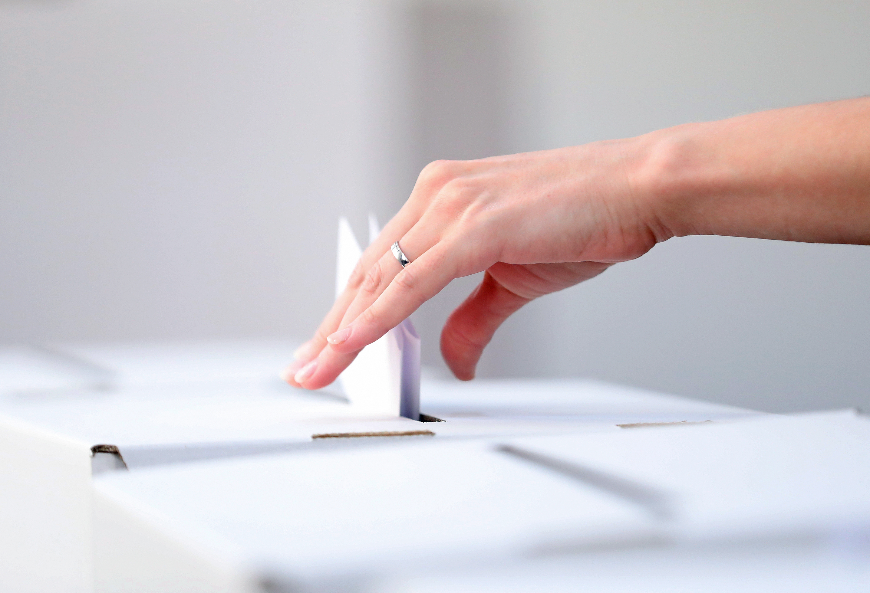
U.S. Election Assistance Commission
NATIONAL POLL WORKER RECRUITMENT DAY GRAPHICS
Graphics Are All Customizable And Optimized For Use on Twitter, Facebook, and LinkedIn

Slide 2
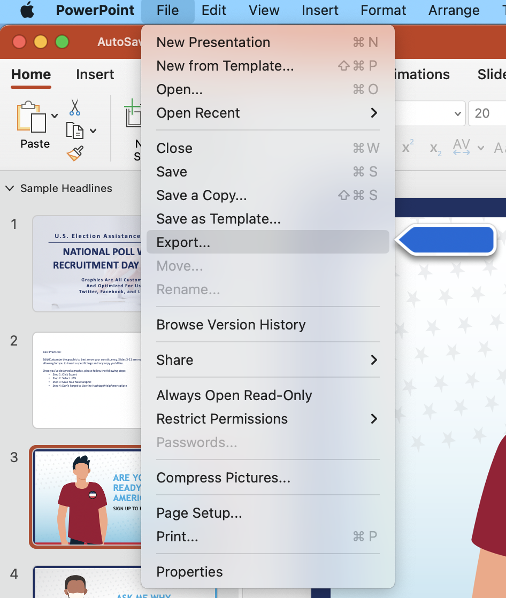
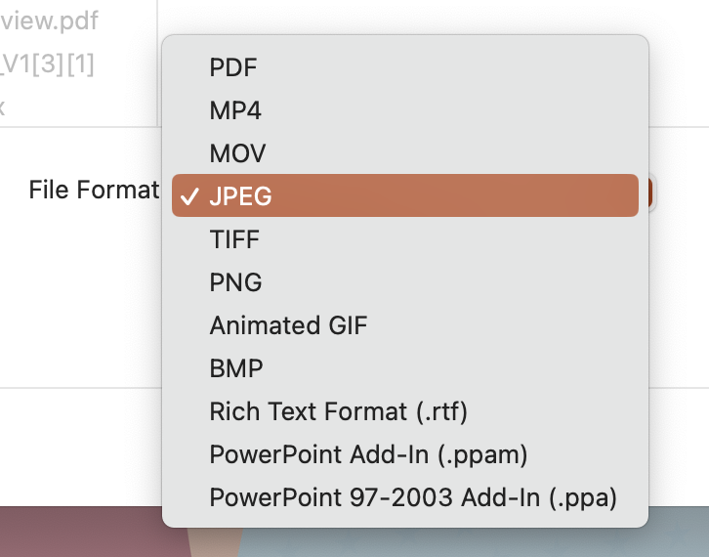
For Mac Users: Best Practices: Step-by-Step Guide To Customizable Graphics
Edit/Customize the graphic to best serve your constituency. Slides 3-11 are ready to publish graphics and slides 12-43 are customizable – allowing for you to insert a specific logo and any copy you’d like.
Step 1
Once you’ve designed a graphic, please follow the following steps:
Step 1: Click File, then Export
Step 2: Select .JPG
Step 3: Save Your New Graphic
Step 4: Don’t Forget to Use the Hashtag #HelpAmericaVote
Step 2

Slide 3
For Windows Users: Best Practices: Step-by-Step Guide To Customizable Graphics
Edit/Customize the graphic to best serve your constituency. Slides 3-11 are ready to publish graphics and slides 12-43 are customizable – allowing for you to insert a specific logo and any copy you’d like.
Step 1
Step 2
Step 2
Once you’ve designed a graphic, please follow the following steps:
Step 1: Click File, then Export
Step 2: Click Change File Type
Step 3: Under Image File Types, Select .JPG
Step 4: Save Your New Graphic
Step 5: Don’t Forget to Use the Hashtag #HelpAmericaVote

Slide 4
ARE YOU READY TO HELP AMERICA VOTE?
SIGN UP TO BE A POLL WORKER

Slide 5
ASK ME WHY I WORK IN ELECTIONS
SIGN UP TO BE A POLL WORKER

Slide 6
ACCURATE ELECTION INFORMATION COMES FROM TRUSTED SOURCES
REACH OUT TO YOUR STATE OR LOCAL ELECTION OFFICE TO LEARN MORE

Slide 7
DID YOU KNOW MOST STATES PERMIT PEOPLE YOUNGER THAN 18 TO BECOME POLL WORKERS?
REACH OUT TO YOUR LOCAL
ELECTION OFFICE TO LEARN MORE

Slide 8
ARE YOU ELECTION READY? IS YOUR COMMUNITY?
HELP AMERICA VOTE

Slide 9
I’M A POLL WORKER BECAUSE…
SIGN UP TO BECOME A POLL WORKER

Slide 10
I’M A POLL WORKER BECAUSE…
SIGN UP TO BECOME A POLL WORKER
Notes:
Swap to old woman

Slide 11
POLL WORKERS HELP AMERICA VOTE
REACH OUT TO YOUR LOCAL
ELECTION OFFICE TO LEARN MORE

Slide 12
BE ELECTION READY
HELP AMERICA VOTE

Slide 13
BE ELECTION READY
HELP AMERICA VOTE

